Slide 1
Seniors in Poland

Slide 2
Initiatives for Seniors in Poland:
Third Age Universities (110 schools, 25000 students)
Senior Clubs
„Seniors help Seniors”
„Szlachetna Paczka dla Seniorów”
Sport & Outdoor activities

Slide 3
Trips around the local region…

Slide 4
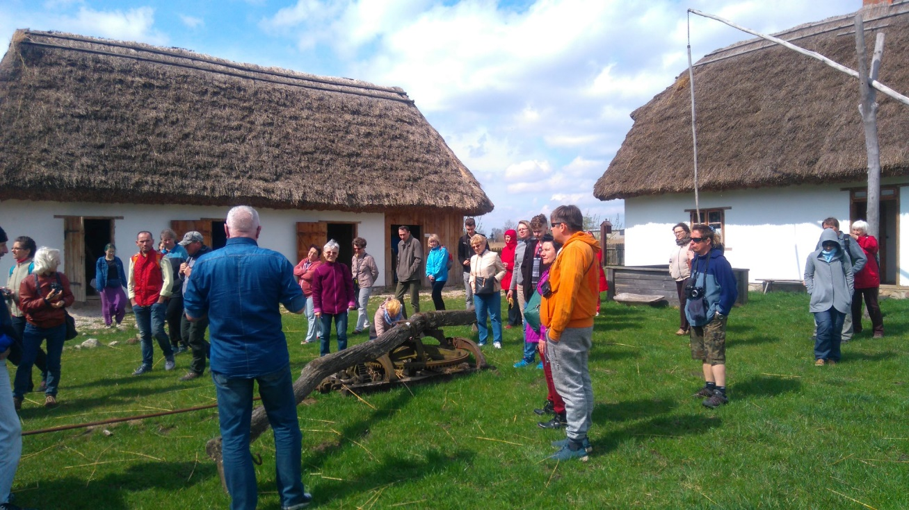
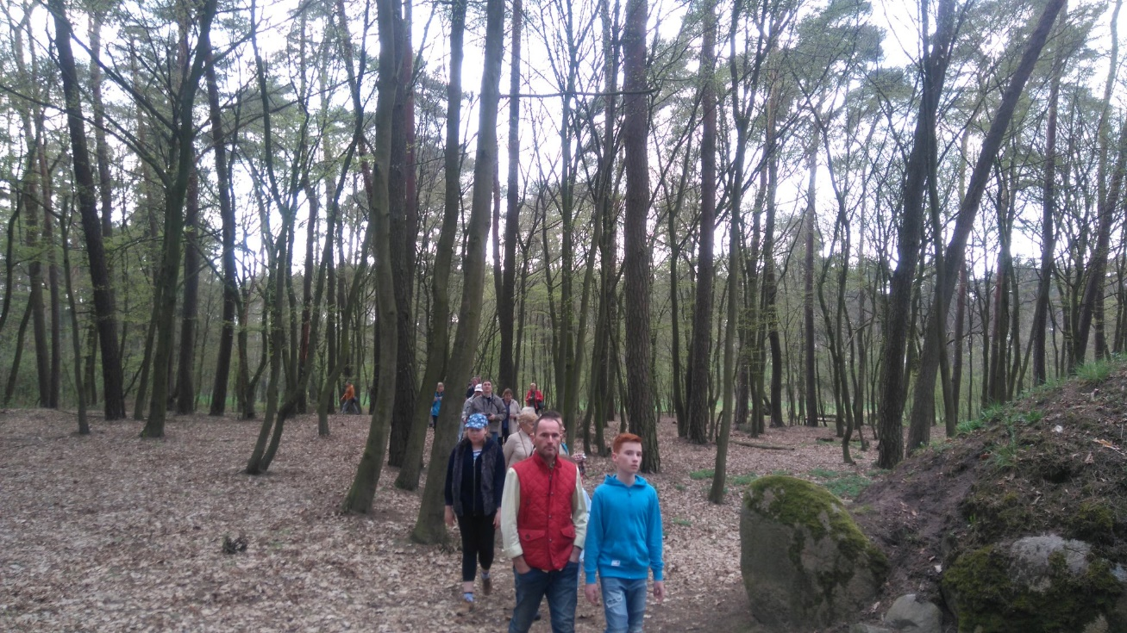
Trips can:
remind the past and tradition
give time to spend with nature

Slide 5
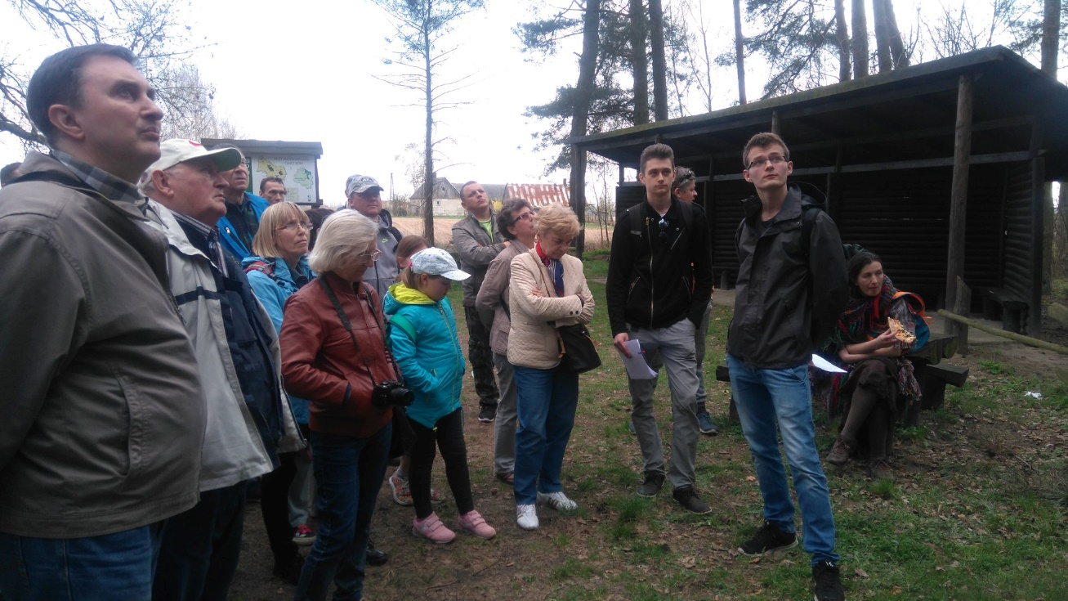
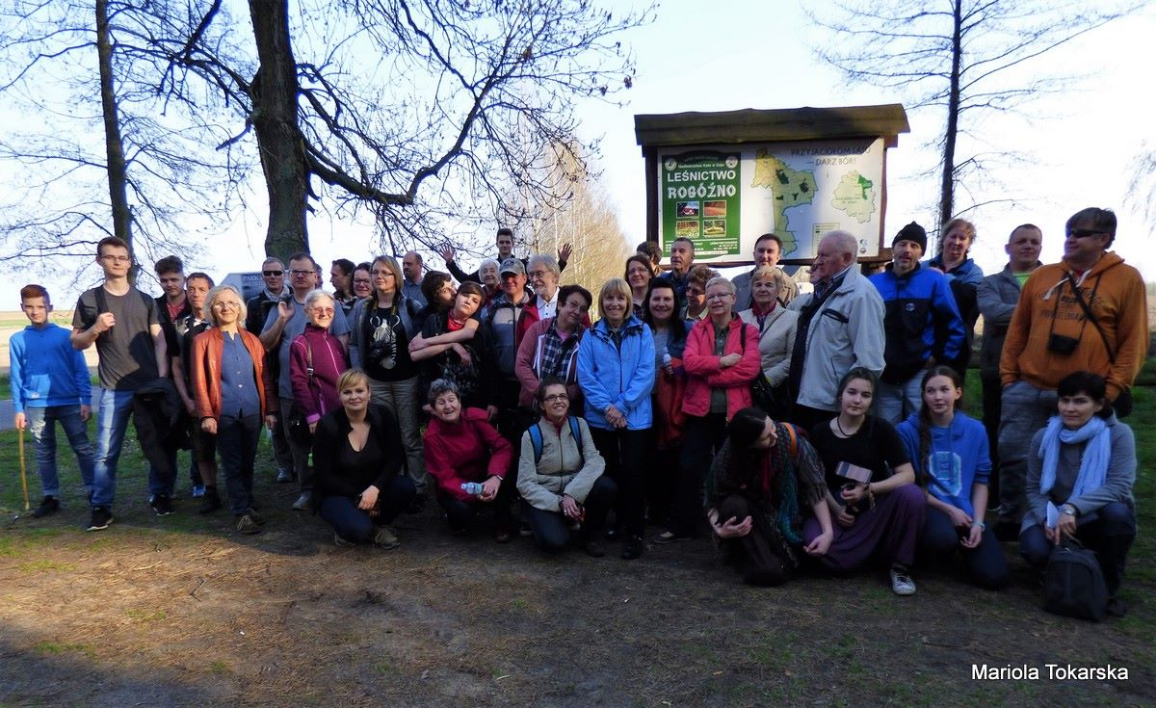
Trips give chance to:
young people to be guides
know each other

Slide 6
Initiatives for seniors in Cracow, Poland

Slide 7

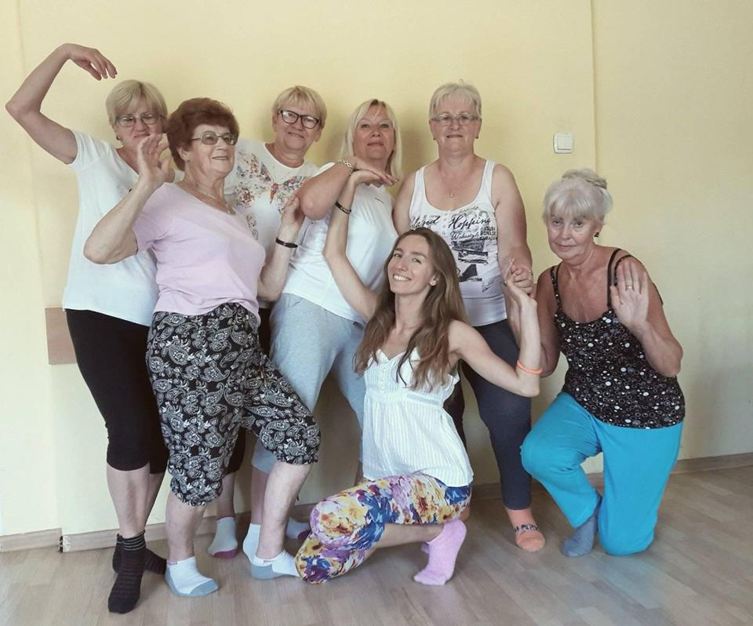
FUNDACJA UKRYTE SKRZYDŁA
Centrum Aktywności Seniorów
PROJEKT: FRUWAJĄCA RYBA
Kraków, Poland
Date of the project: 02.2017 – 12.2018
participants+60 years old
Many activities: english language course, IT classes, New Technology consultations, Artetherapy workshops, choir, table tennis, tailoring workshops, table games, dancing classes
Everyday different activities
Monthly cost: 5 PLN ~ 1 EURO
~~ Seniors like art activities, playing roles, poems,
making cuddling toys for kids,
writing their own scenarios… ~~

Slide 8

PROJECT: ZŁOTA RĄCZKA (handyman)

Slide 9

SENIORALIA 2018
3 DAYS EVENT (7-9 of June 2018)
Every day in the different place of the city: concerts with famous cracov artists, dance performance, contests with prizes, theatrical performance of seniors…
During the event it was possible to obtain: pharmaceutical advices, measure the blood presure, examin the complexion, get dermatological advices.

Slide 10
Initiatives for seniors in Warsaw, Poland

Slide 11
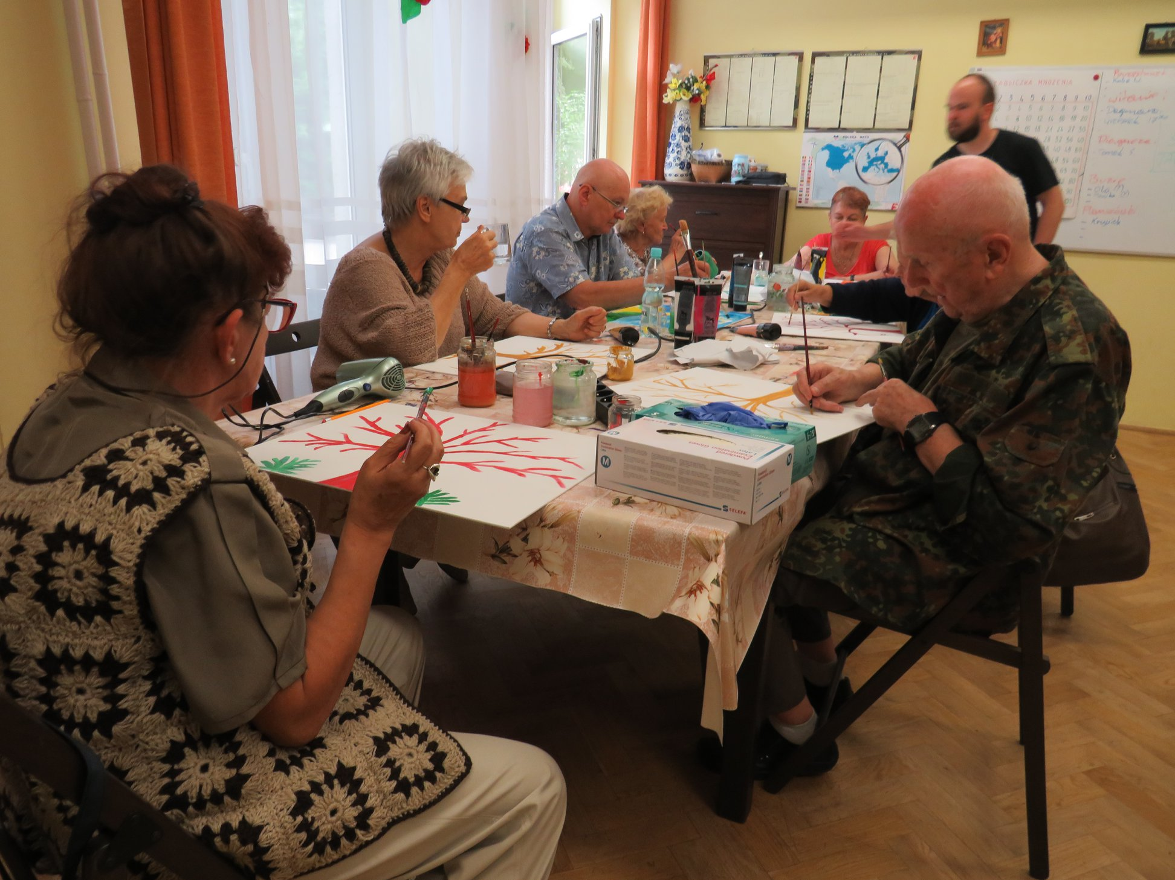
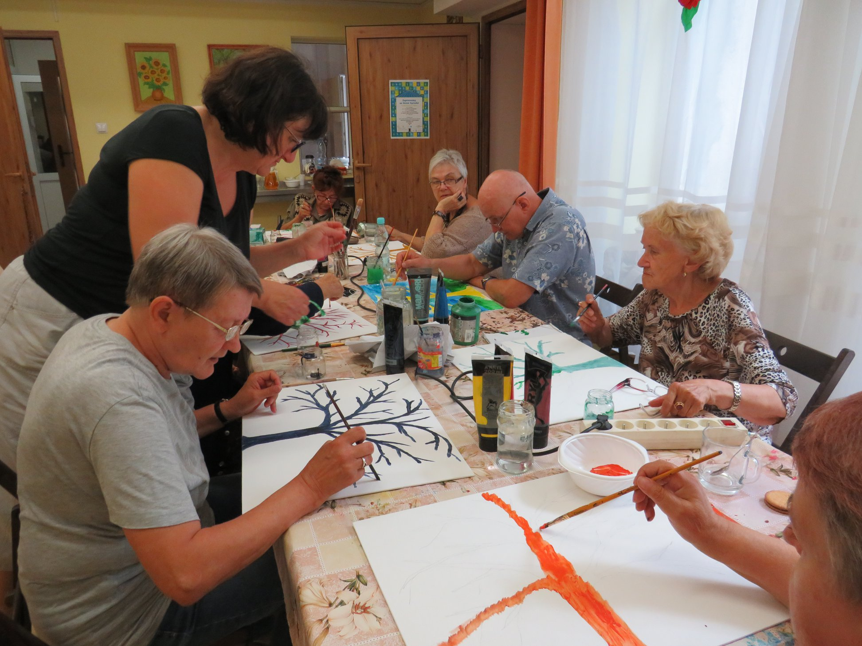
„Spotkajmy się na Twardej”

Slide 12
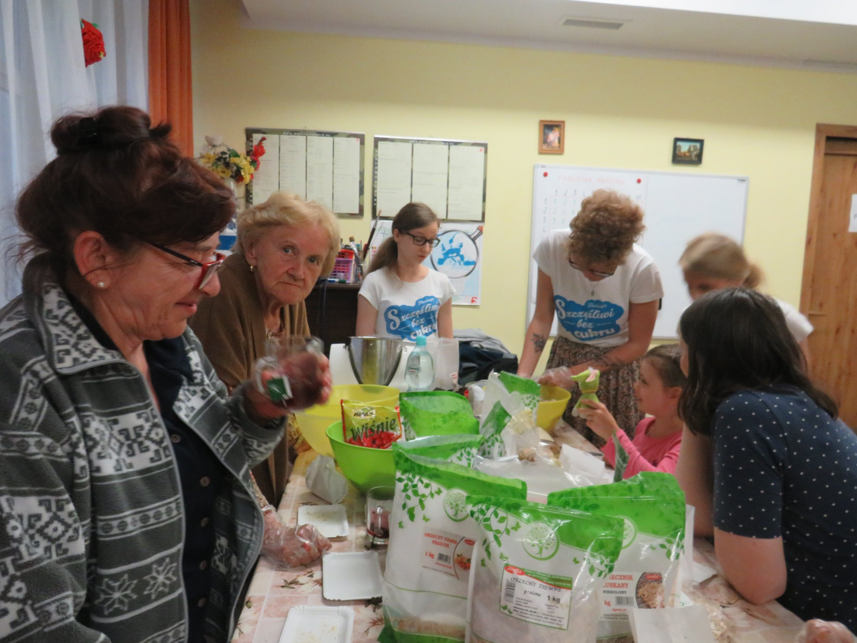
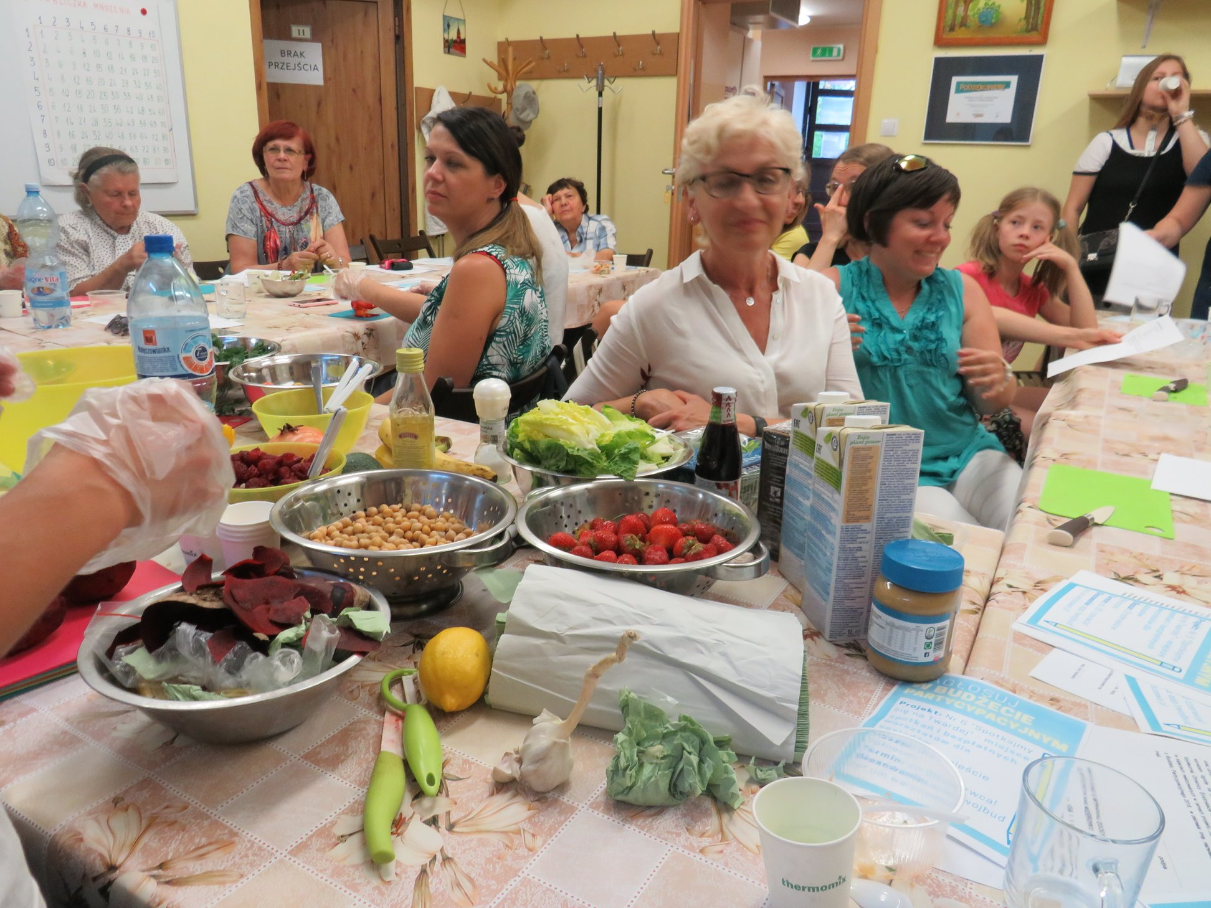
„Spotkajmy się na Twardej”

Slide 13
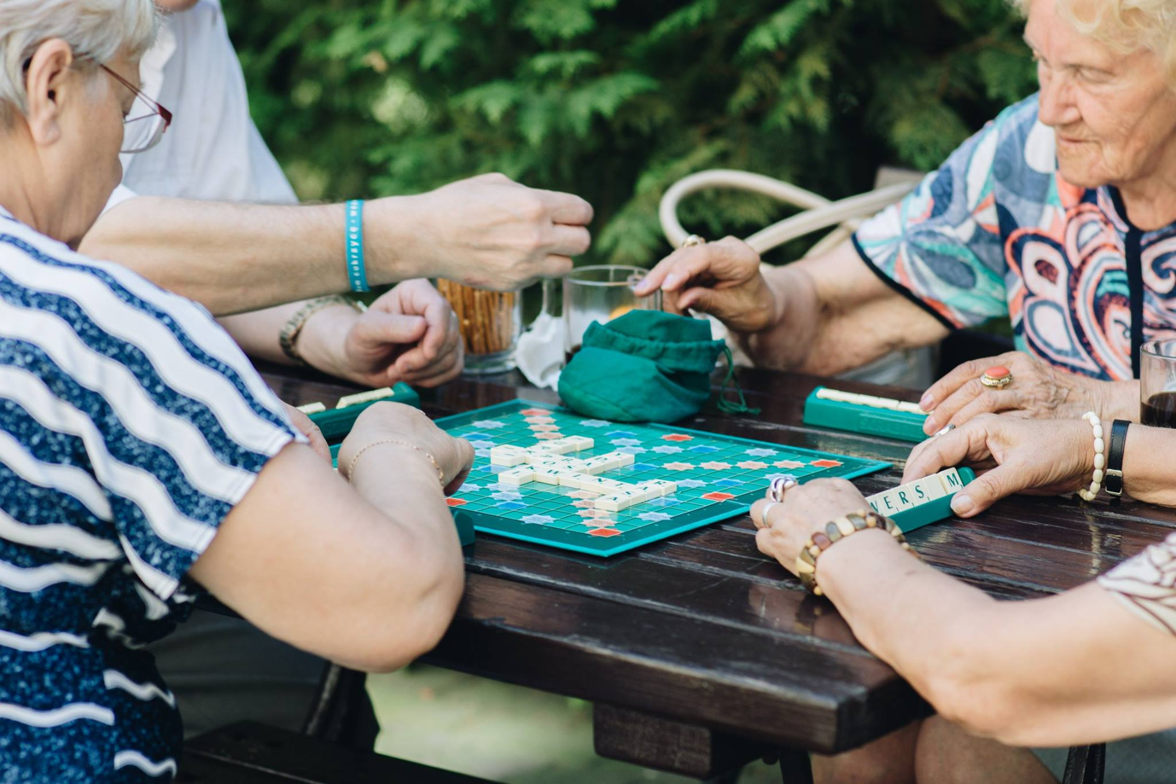
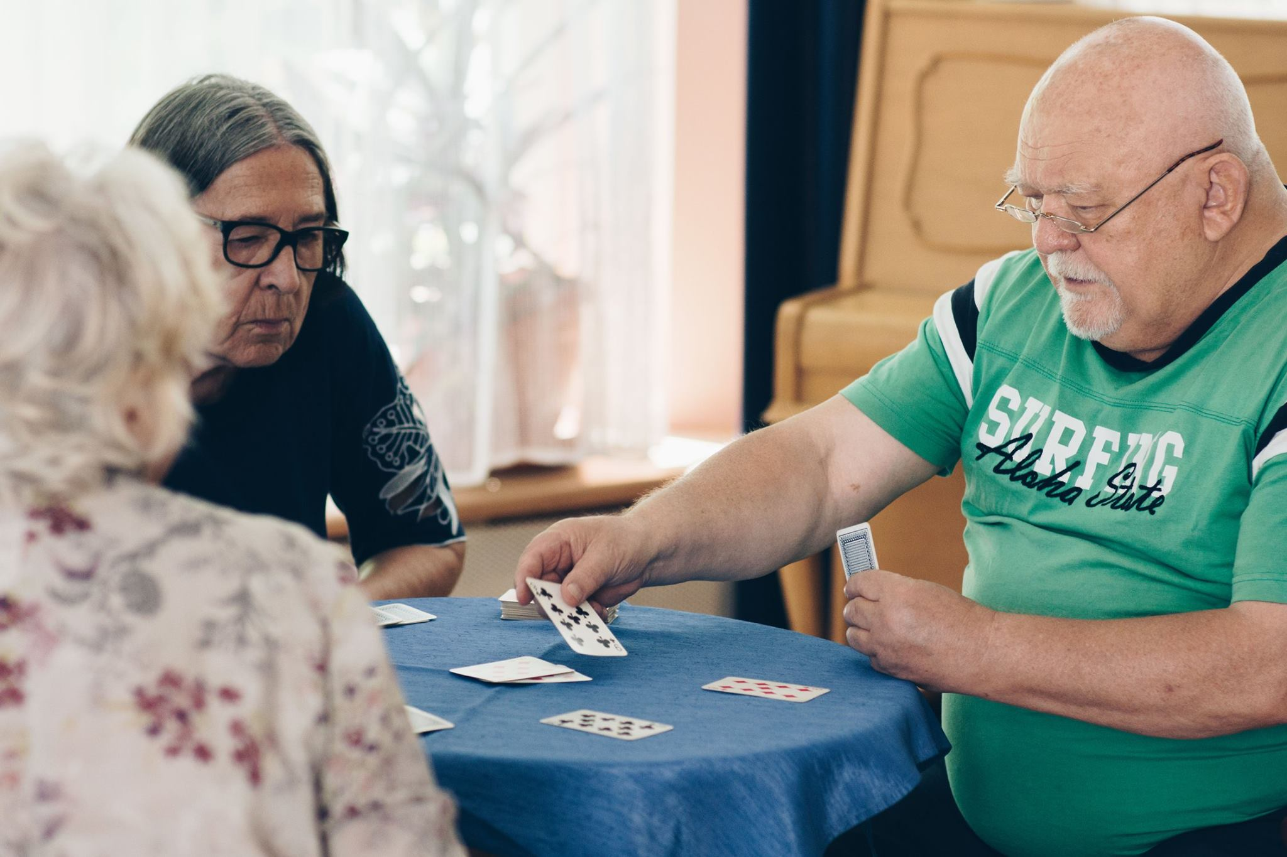
„Spotkajmy się na Twardej”

Slide 14
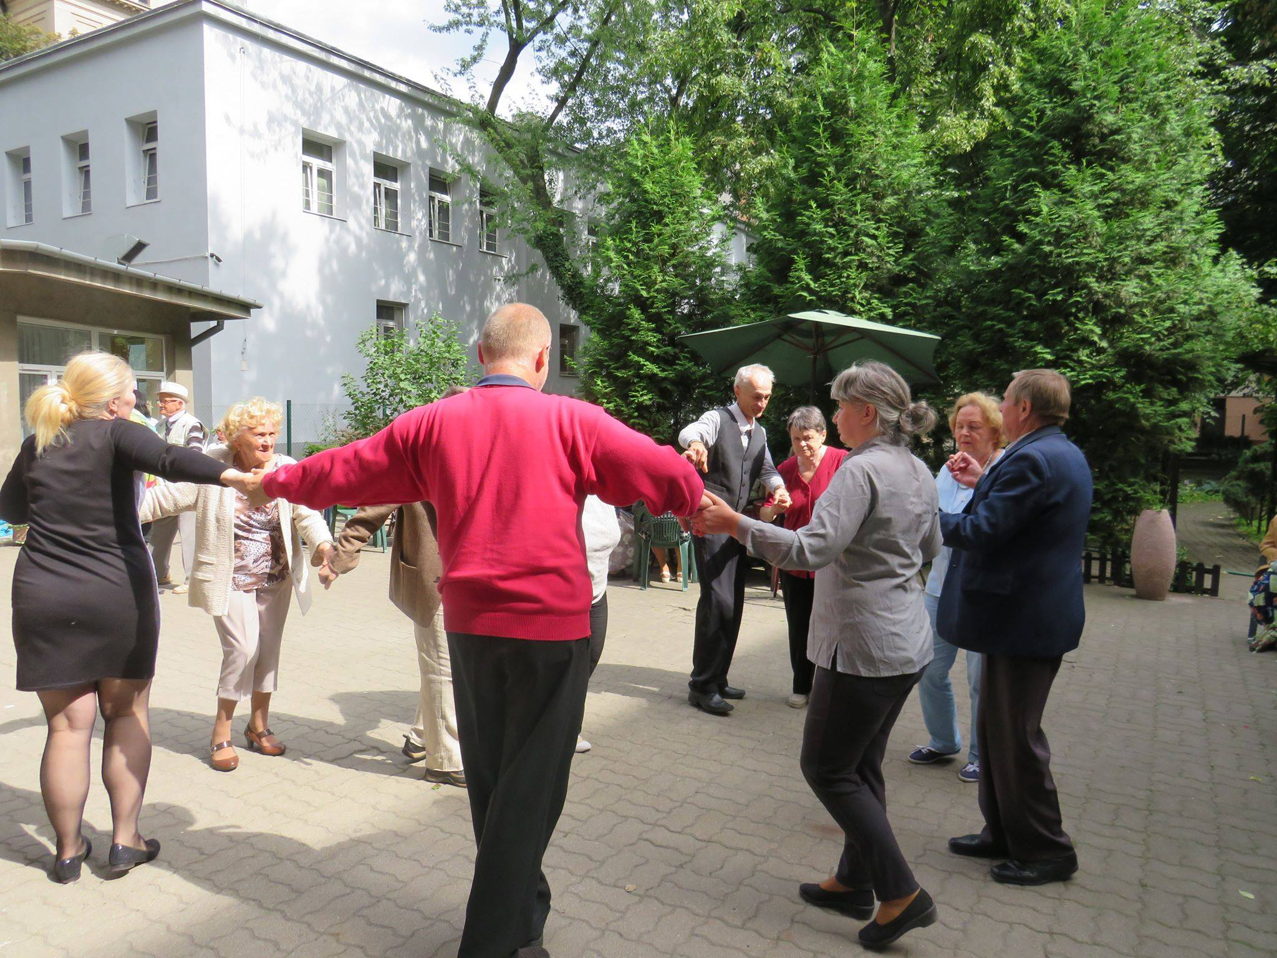
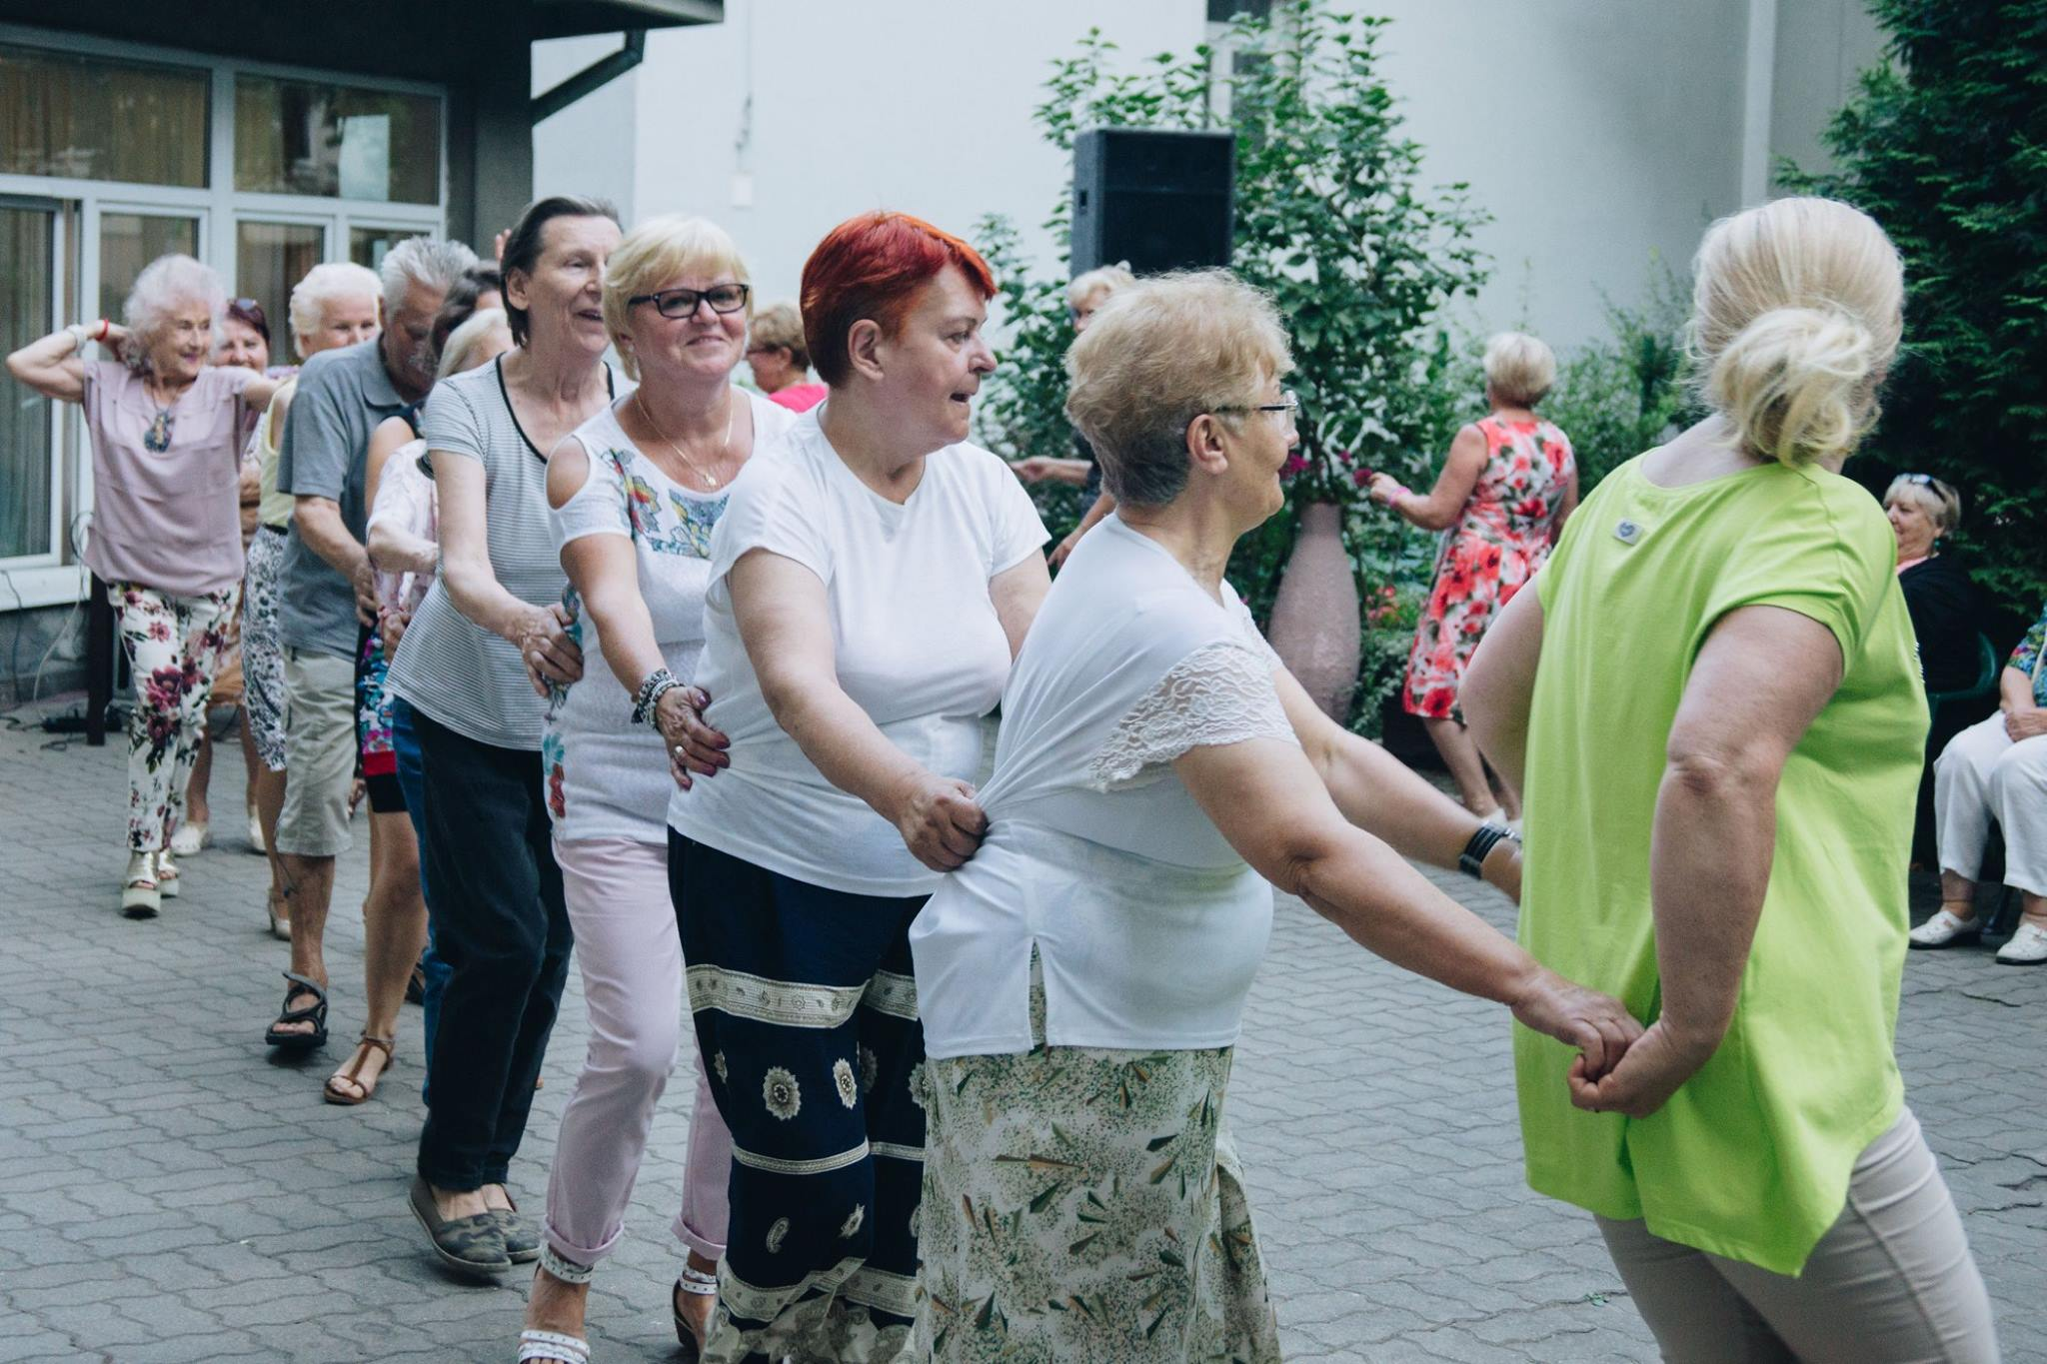
„Spotkajmy się na Twardej”

Slide 15
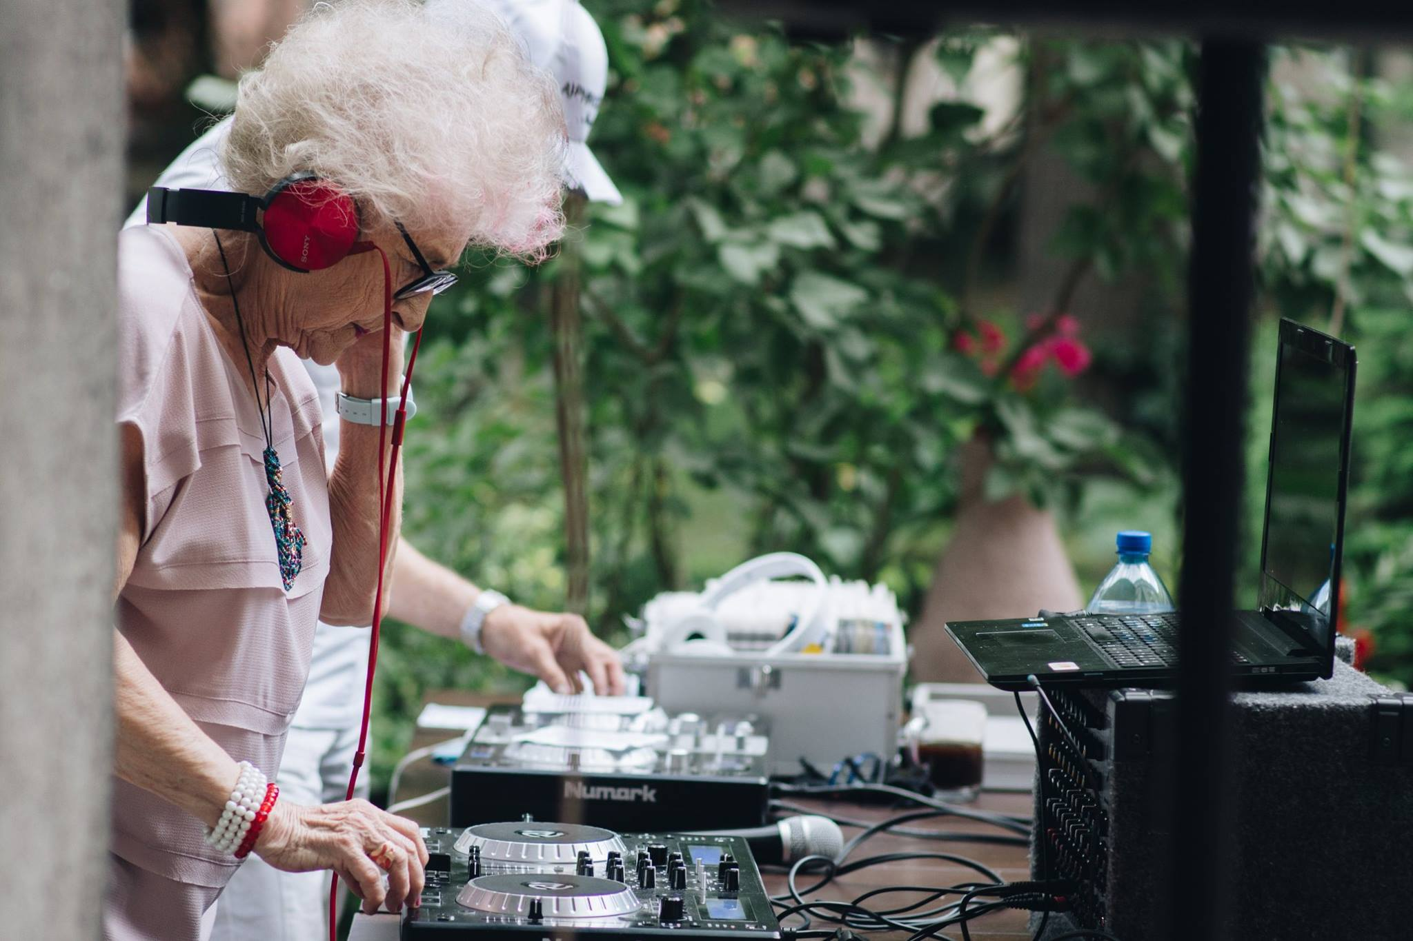
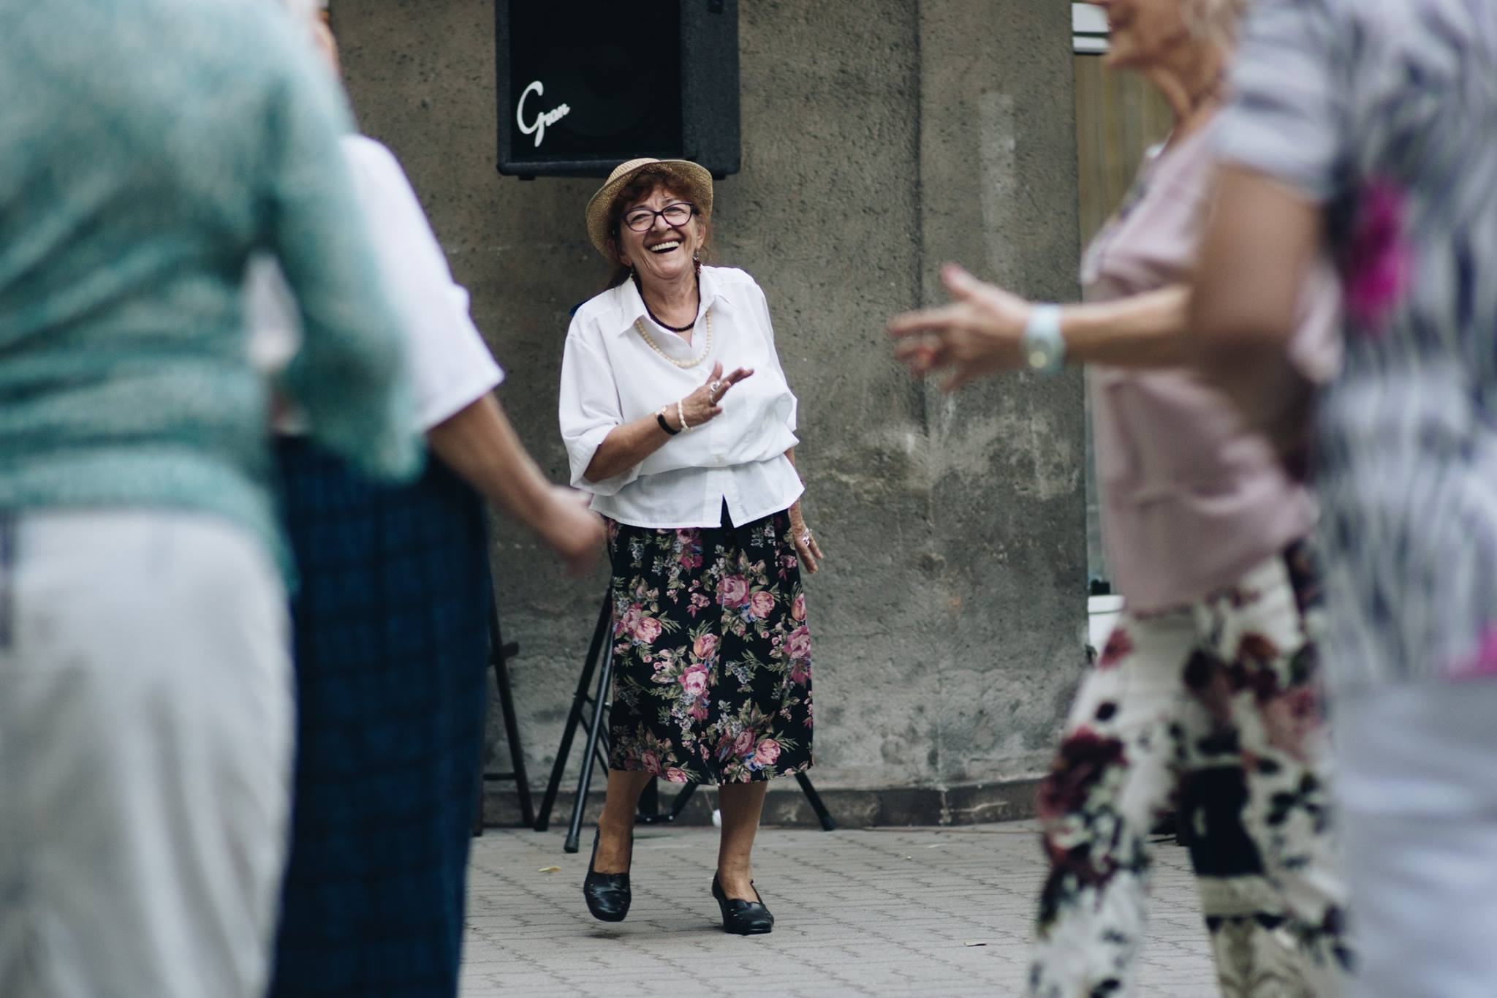
„Spotkajmy się na Twardej”

Slide 16
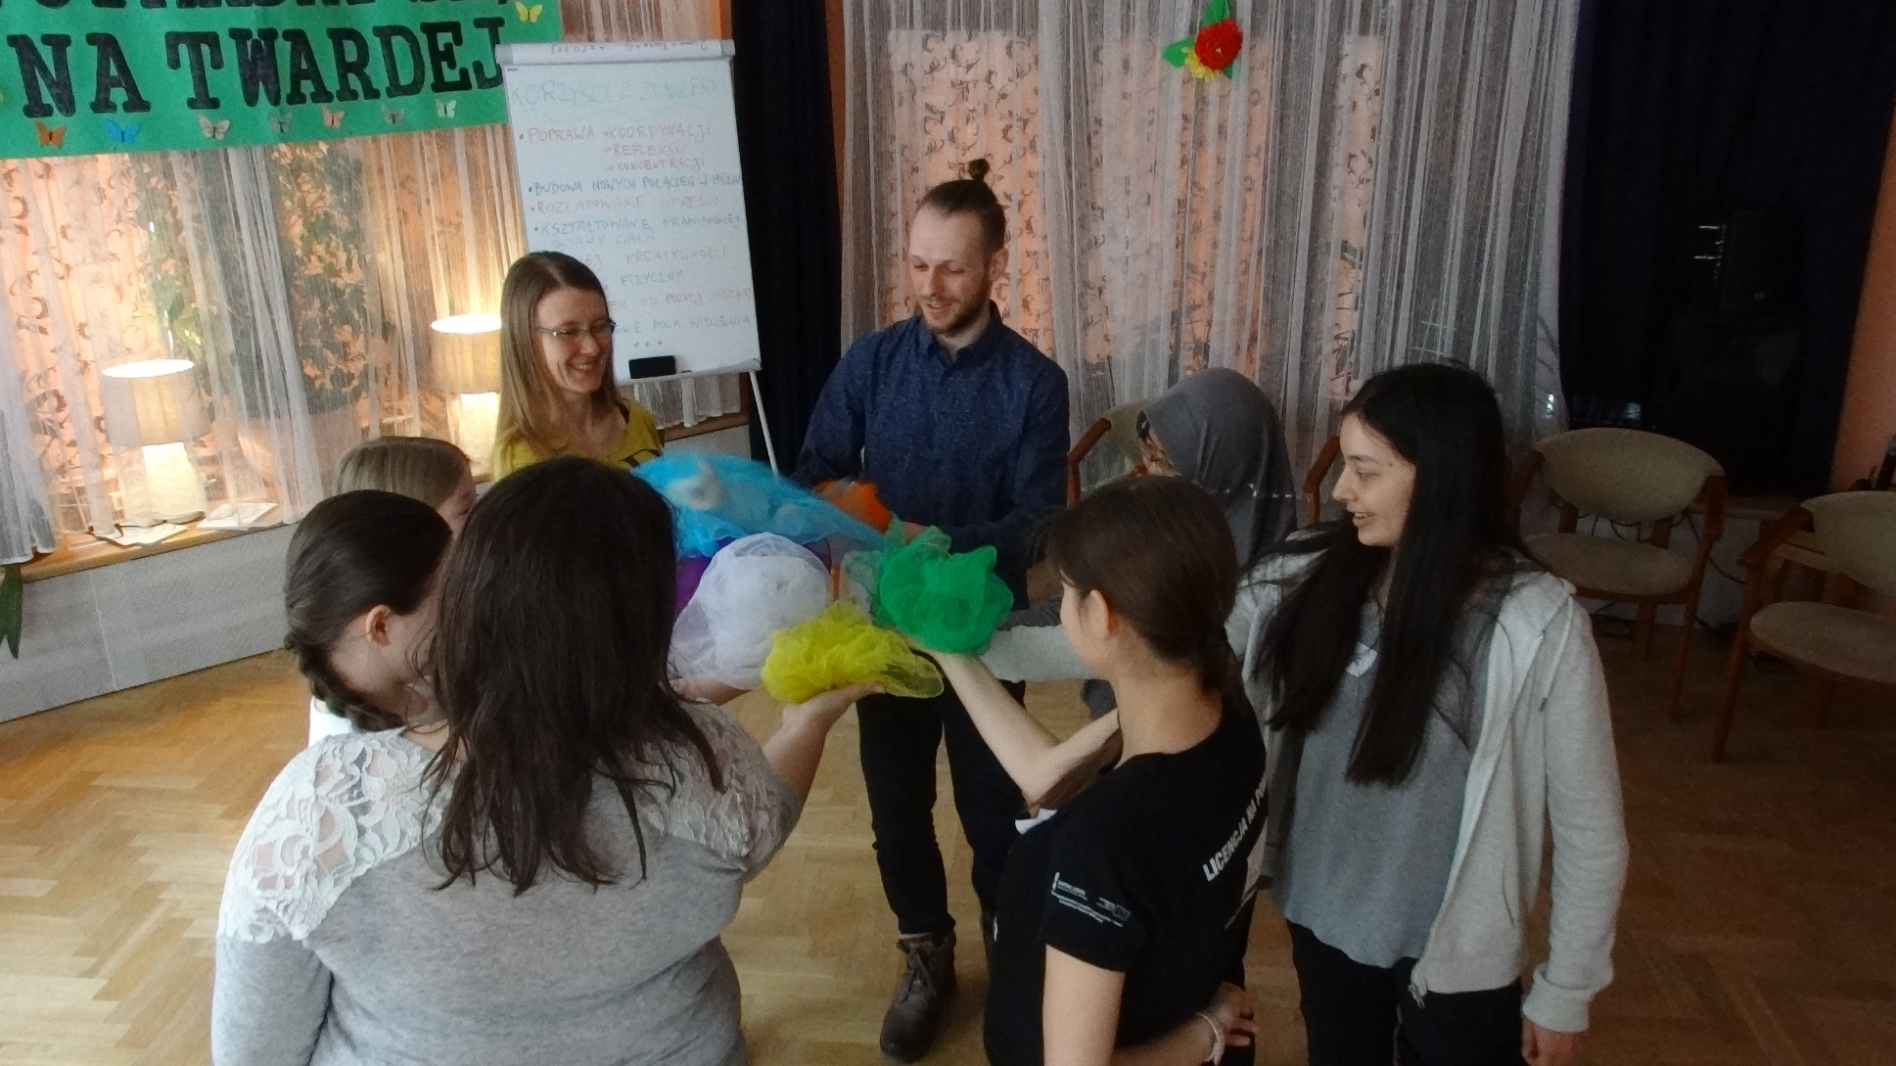
„Spotkajmy się na Twardej”

Slide 17
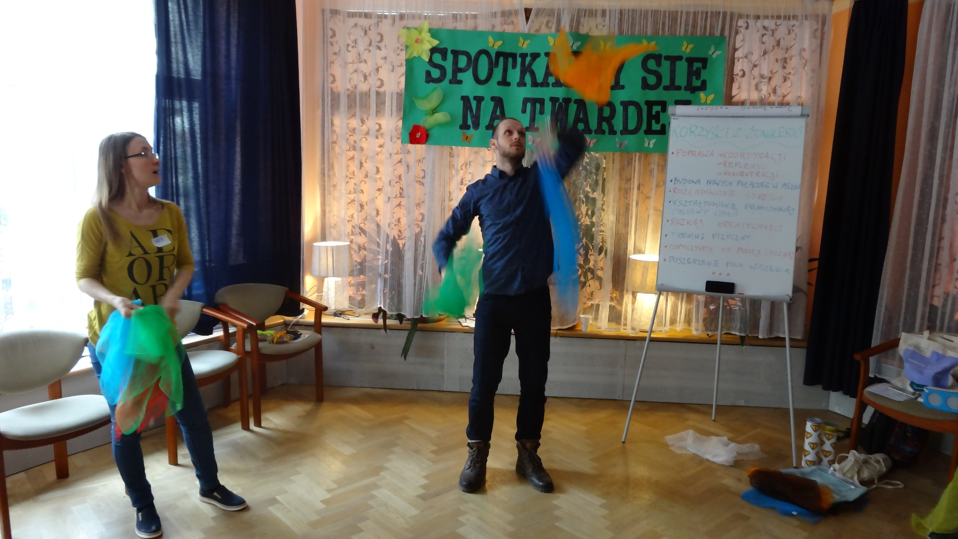
„Spotkajmy się na Twardej”

Slide 18
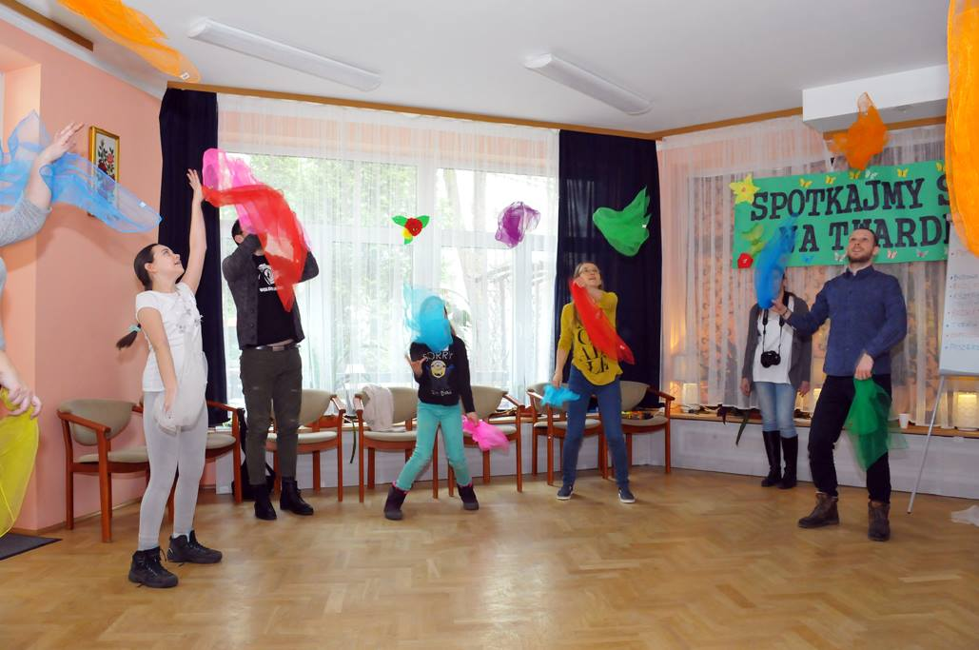
„Spotkajmy się na Twardej”

Slide 19

FUNDACJA MOCNI MIŁOŚCIĄ
The foundation was created to help the elderly and chronically ill.
Volunteers take special training and thanks to that they give help depending on needs. For example, they can help in everyday in everyday activities like feeding, shoping or walks.

Slide 20
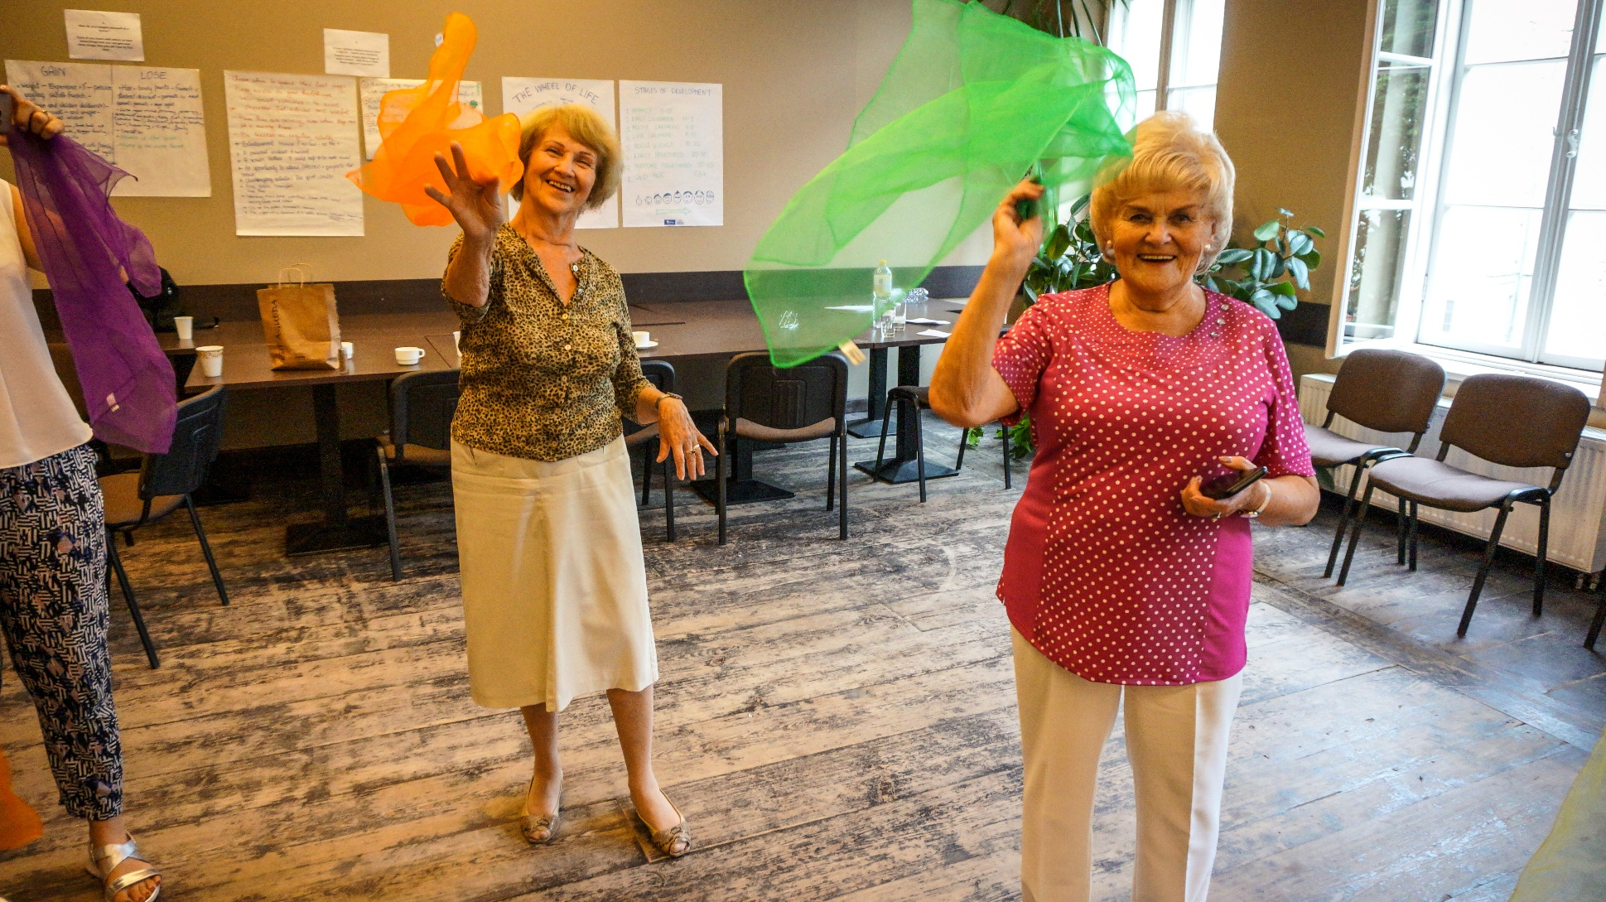
Seniors involved! ;)

