Slide 1
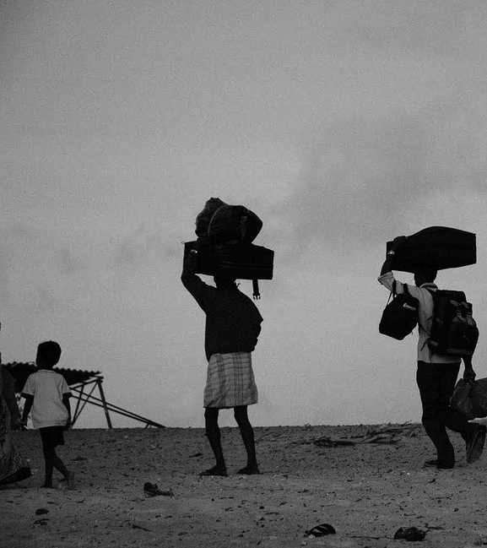







integrating refugees through youth work activities
Research on youth work role in supporting social integration of refugees

Slide 2
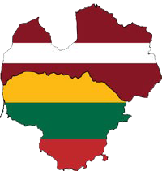
Implementation of research: July – September 2016.
Location of research: Lithuania and Latvia.
Research is made to provide related evidence for enhancing youth work practice, to understand better the current reality, the potential of youth work in coordinated intervention of social integration of refugees in new communities. The aim of research is to examine the possibilities of integrating refugees through youth work activities in Lithuania and Latvia.
integrating refugees through youth work activities

Slide 3
In order to achieve the objectives of the study, qualitative research strategy was chosen.
Literature review: already done researches on integration of refugees as well as documents and strategies applied on the European level.
In-depth interviews with:
Representatives of the organizations that are working with refugees on daily basis. Two types of organizations were chosen: state institutions ( 4 interviews) and NGO’s (4 interviews).
Youth workers, working in youth centers in different regions of Lithuania (3 interviews) and Latvia (3 interviews).
Young refugees (6 interviews) via the social workers that are working with them directly.
Focus groups were organized with 2 different groups: youth centre users (14 - 21 years old) and young people from youth NGOs (17 - 29 years old). 4 focus groups were organized in total (2 in Lithuania and 2 in Latvia).
The participants of the study were chosen based on purposive sampling that was complemented by snowball sampling. In order to achieve better geographical coverage Skype (video call) interviews were conducted as well as the live meetings with participants of the study.
integrating refugees through youth work activities

Slide 4
Opinion from representatives of the organizations, that are working with refugees on daily basis
Key factor for successful social integration –
MOTIVATION TO STAY
SOCIAL TIES
If there aren’t…
If there is
… is key factor to leave.
… helps to feel
social safety.
… helps with finding
accomodation and work.
Success of integration and creating social ties are a lot more frequent among young people.
integrating refugees through youth work activities

Slide 5
Main integration problems:
Opinion from representatives of the organizations, that are working with refugees on daily basis
Lack of financing, time and human recourses
Individual approach to each refugee is needed that their social integration would work.
Stereotypes and prejudies
But...
Language barrier
The starting point for all the refugees is the same and everyone is given equal support that does not depends on their need.
integrating refugees through youth work activities

Slide 6
Opinion of youth workers
possibilities for communities to get acquainted with refugees:
breaking stereotypes and prejudices
Possibilities to be included in the activities, provided by youth centers:
variety of activities (playing games, cultural evenings, cooking, quizzes, programming, playing musical instruments, dancing, trips, camping, etc.);
treatment as any other young person;
place to make social ties.
Working together and interaction between youth worker, community and refugees can bring mutual benefit
educational opportunities for young people in joint activities with refugees:
addressing diversity, more topics for discussions, broaden minds, appreciate the differences
integrating refugees through youth work activities

Slide 7
Concerning cultural differences young people are:
Opinion of young people
cautious about the different norms that exist in the societies and if the refugees would be able to adjust to the rules and laws of Latvia or Lithuania
very curious about the cultures of the people who are coming to their countries and are expressing their positive attitudes towards variety and learning about them
Respect of cultures need to be both-sided
integrating refugees through youth work activities

Slide 8
Opinion of young people
Proposed 3 types of participation in youth centre or youth NGO
Young refugee as a service user
to attend organized events
to come for consults regarding adjusting to a new city, knowing the opportunities for studies or work
to be represented as any other foreigner (for example in student unions)
Young refugee as a resource
to involve them into the events as special guests
or if the refugees would decide to join the NGO, to use their knowledge and experience to help other refugees
Young refugee as a member or co-worker of an NGO or an attendee of a youth centre
according to their interests
to join in the regular activities of youth centre
to join the organizations and be accepted
to be as co – worker according to their knowledge and experience
integrating refugees through youth work activities

Slide 9
Thoughts from refugees
First to survive...
...and then participate
Refugees would like to be invited to join the organizations or youth centres as they are aware of the public opinion and do not feel too confident to simply appear
willingness to join offered activities depends on their situation:
if they are single or comming with family,
do not have psychological problems,
already are studying or working,
have no problem with housing,
etc.
Participation in proposed activities has to have a clear added value for their integration in order to support their motivation to be active.
They would like playing games, watching movies, participate in cultural evenings or trips, cooking, making crafts, creating websites (learning how to do it), playing musical instruments, etc.
integrating refugees through youth work activities

Slide 10
integration opportunities and challenges
Youth workers understand the challenges of refugees joining the youth centres and at the same time are very keen on including them in the daily activities of youth centres
The real challenges might be different and more complex;
Daily activities might not be interesting or relevant;
Extra efforts to make the activities more accessible to refugees need to be put;
Negative opinion about refugees in the communities might lead to young people, who are currently visiting youth centres, to quit or change the organization.
integrating refugees through youth work activities

Slide 11
integration opportunities and challenges
Young refugees need to be treated as any other young people who have their interests, opinions, problems, etc.
Refugees are coming from different background, have difficult experiences and are facing more complex challenges that need to be addressed individually.
Cultural differences need to be taken into account.
integrating refugees through youth work activities

Slide 12
integration opportunities and challenges
Youth organizations are open for new members or new employees with migrant background, and see them and their experience as valuable recourse.
Active participation in civic life might be not attractive if young refugees do not have similar experiences in their native countries.
Joining NGO is not on top of their priorities.
Different working culture.
All information about organization, all documentation and activities are held in national language.
integrating refugees through youth work activities

Slide 13
integration opportunities and challenges
Youth centres and youth NGOs are a space to improve national language.
Some activities can take longer to explain or to implement. Some youngsters can be unsatisfied about this situation.
Some activities will have to be adapted to the special needs of foreigners.
integrating refugees through youth work activities

Slide 14
integration opportunities and challenges
Young people from youth NGO’s see themselves as a resource to raise awareness of refugees in their communities.
Organizations might be losing their regular scope of activities;
Refugees don’t want to be public and want their privacy to be respected.
Communities in small towns can be reluctant.
Relatives of young people might encourage them to quit initiatives that they have started.
integrating refugees through youth work activities

Slide 15
integration opportunities and challenges
Prejudices and stereotypes existing in the society can be changed through interaction with young people
Refugees don’t want to be public and want their privacy to be respected, so they might refuse to cooperate.
Young people who have more international experience might not be interested in such activities.
integrating refugees through youth work activities

Slide 16
integration opportunities and challenges
Youth centres and youth NGOs are offering space and different possibilities for refugees to build social ties in local communities.
Bullying is a possibility.
If the first contact is negative, future interaction would be a lot more difficult to encourage.
Language barriers.
Cultural differences.
integrating refugees through youth work activities

Slide 17
integration opportunities and challenges
Youth NGO’s as a platform to implement ideas and receive support.
Complexity of such activities is requiring having similar experience and high motivation.
Cultural differences.
integrating refugees through youth work activities

Slide 18
integration opportunities and challenges
Youth organizations can provide various services
Language barriers.
Doubts about professionalism of provided services.
integrating refugees through youth work activities

Slide 19
integration opportunities and challenges
Youth workers have most of the competences to work with refugees
Lack of attention for special training.
In the process new challenges can appear and youth worker might not get relevant support.
integrating refugees through youth work activities

Slide 20
integration opportunities and challenges
Internet consultations on various topics are useful and efficient way to help refugees in the way of settling in a new country.
Lack of interpersonal communication will not lead to socialization.
integrating refugees through youth work activities

Slide 21
integration opportunities and challenges
Youth sector is open for cooperation with other organizations.
Difficulties to find common ground for cooperation between different sectors (work culture, attitudes, aims, measures, norms, etc.).
Different expectations of cooperation and its results.
Project based/ short-term cooperation.
Time consuming.
Cooperation understood as an aim itself.
integrating refugees through youth work activities

Slide 22
integration opportunities and challenges
Youth organizations can be a key actor for different initiatives with media
Refugees don’t want to be public and want their privacy to be respected.
Lack of good examples.
Communities in small towns can be reluctant.
integrating refugees through youth work activities

Slide 23
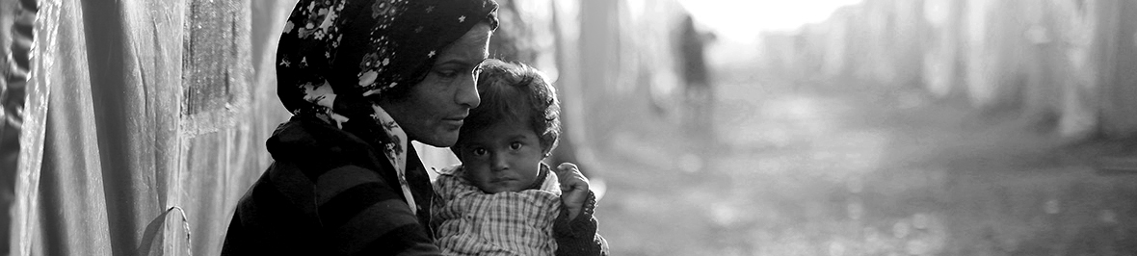
RECOMMENDATIONS
For:
Youth workers
Youth centres
Youth NGOs
Young people

Slide 24


A closer cooperation between youth NGOs, youth centres and the organizations, that are in charge of the socialization of refugees in the country needs to be encouraged.
Youth centres and youth NGOs could involve people of migrant or refugee background into activities where they could meet and socialize with locals.
Using already existing activities young people should contribute to building up the social ties between refugees and the local community.
Organizations, working with refugees
Youth centres, youth NGOs
integrating refugees through youth work activities

Slide 25
Youth organizations and youth centres are welcome to approach organizations, that are working directly with refugees and discuss possible cooperation. Youth centres and youth NGOs can bring added value to already existing integration measures.
Youth organizations should join other actors in the field and provide services for young refugees, such as psychological or academic consultations. It is important to involve target group of proposed services in constructing such services in order to meet their needs.
Open youth centres, focusing on the social work with young people, are contributing a great deal to the integration of socially vulnerable groups in different cities and towns; they can be one of the key actors in socialization of young refugees.
The organizations, that are already working with refugees should cooperate with youth organizations in putting effort to influence the media coverage of the refugee’s topic.
integrating refugees through youth work activities

Slide 26



Two-way integration models have to be implemented.
There are two groups of beneficiaries:
those, who are refugees or asylum seekers and
those, who are members of the local community.
NGO’s should be working towards local communities to be more tolerant.
Youth workers should take into consideration that even though they do not have to "put out the fires" and start working with young refugees now, they should be dedicating the time and start preparing young people for interaction and living with others.
Integration of refugee
Work with local community
Integration of refugee
Work with local community
integrating refugees through youth work activities

Slide 27
Before starting work with social integration of refugees...
Youth centres and youth NGOs
Have to assess their own capabilities, resources, etc.
Open youth centres
Must to think out well each element of interaction.
Youth workers
Need to receive training on working with young people from refugee background and including them into activities with local youth.
Organizations shouldn’t depart extremely from what they do the best. “Hunting for finances”, were additional funds are allocated can lead to distortion of institution.
It should start with the simplest activities, giving time for refugees to do nothing, not to put pressure and high expectations.
The training should include intercultural learning, human rights education, diversity, work with groups, conflict management, and interfaith.
integrating refugees through youth work activities

Slide 28
What can we learn from examples of best practices from other countries...
CZECH REPUBLIC. The campaign „Express your solidarity with refugees!” is promoting tolerant debate around refugees. It calls on citizens not to be silent and publicly denounce racism and xenophobia.
AUSTRIA. "Refugee Buddies" programme - locals engage voluntarily at a variety of organizations, and meet regularly with one refugee, in order to establish personal relations. The programme "Mentoring for migrants", has been extended to highly-qualified refugees. the Austrian Federal Train Service (ÖBB) started the "Diversity as Chance" ("Diversität als Chance") project and offered 50 unaccompanied refugees between 15 and 17 year old apprenticeships. Open youth centres in Austria are actively working with young refugees by involving them into daily activities.
HUNGARY. The „Welcome Migrants“ project is producing short documentary clips featuring four well-known public figures welcoming a migrant in their home for a week.
GERMANY. Local sport clubs are responsible for organizing activities for immigrants since 1989. The aim of the programme “Integration through sport” is to allow immigrants to participate in the life of various different associations and in training and competitions over the long term.
SWEDEN. The Wallenberg Foundation is implementing support education and training activities for young people and refugees from disadvantaged areas. The initiative includes summer schools in scientific subjects, intensive courses in Swedish, and tutoring for students who have recently arrived.
integrating refugees through youth work activities

Slide 29







PARTNERS

Slide 30
Thank you!
integrating refugees through youth work activities

