Slide 1
Cycling culture in Lithuania
Rūta, Eglė, Edminas, Aurimas

Slide 2
Introduction
The length of bike roads in the biggest cities of Lithuania:
Vilnius – 111 km (2017)
Kaunas – 62,2 km (2016)
Klaipėda – 95,5 km (2013)

Slide 3
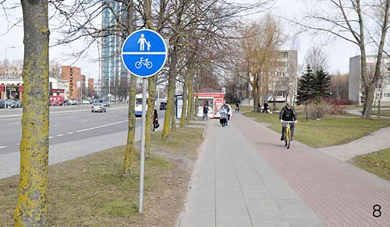
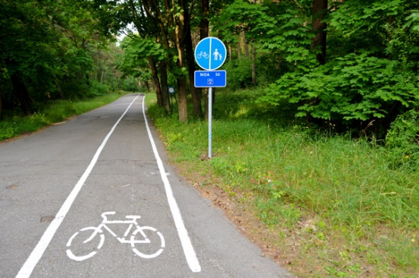
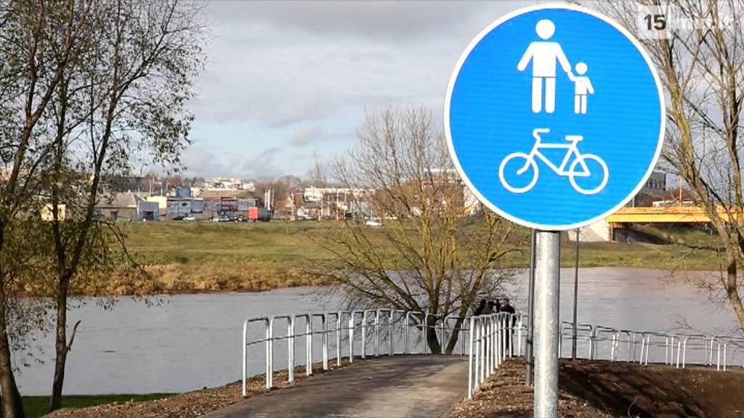

Slide 4
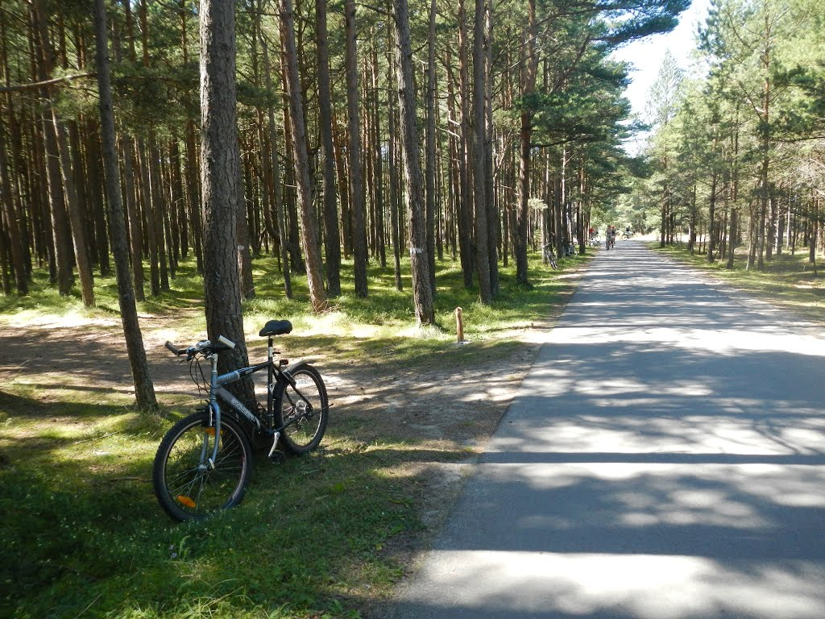
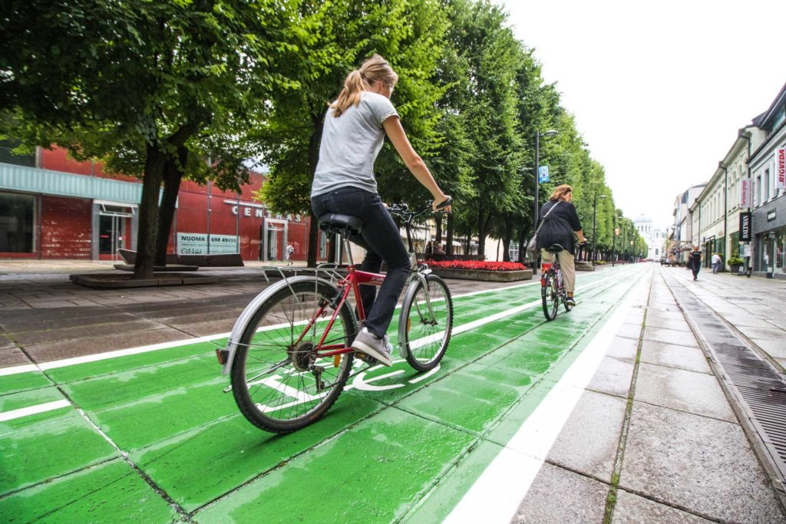
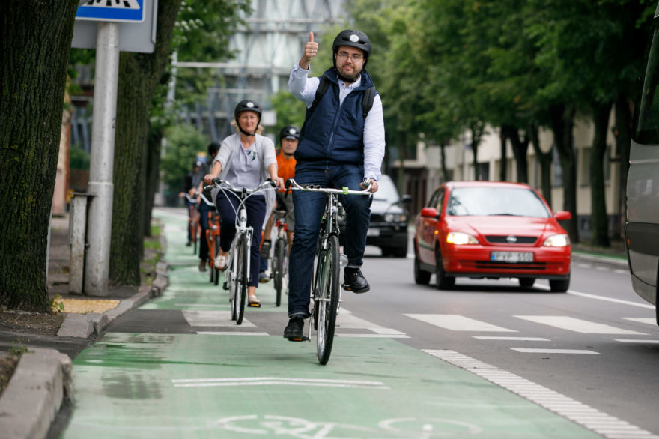

Slide 5
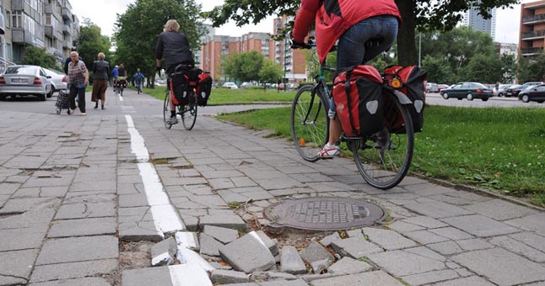
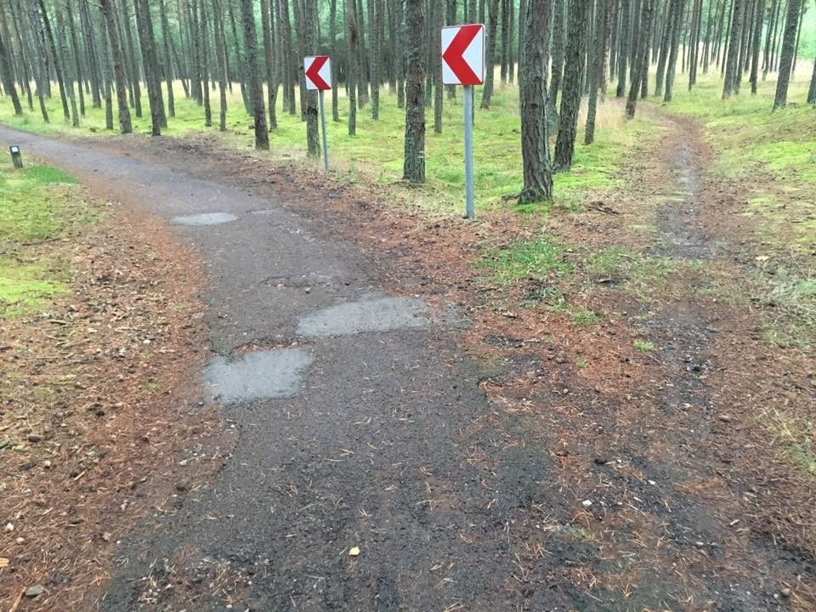

Slide 6
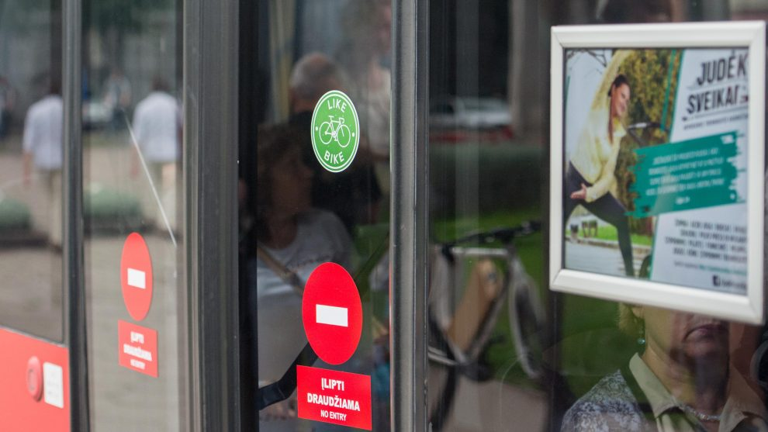
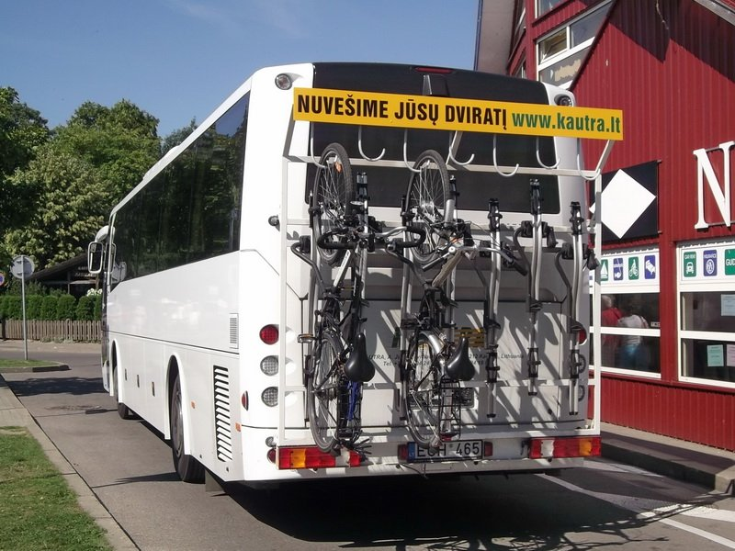
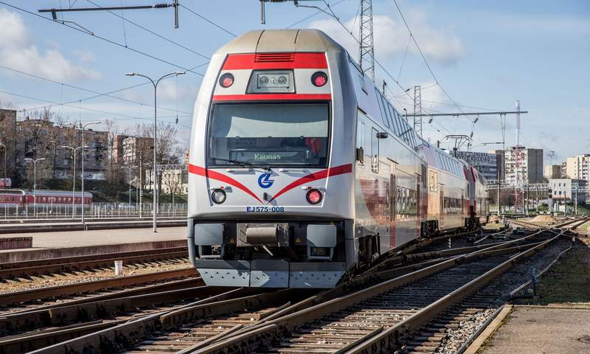
Traveling
In public transport (buses and trolleys) and intercity buses (if they are adapted) you can carry a bike for free.
Although, carrying a bike in a train costs.
For example, by taking a train from Kaunas to Vilnius or vice versa, the ticket for a one person with a bike costs 9,24 euro, while without one – 6,27 euro.

Slide 7
“Cyclocity Vilnius”
“Cyclocity Vilnius” is the first bicycle system in Lithuania, which was installed in Vilnius in 2012
This means of transport helps to reduce the city’s pollution – it is estimated that by choosing a bike instead of their car in the year 2016, users of “Cyclocity Vilnius” saved the city from 80 000 kg of CO2 waste.

Slide 8
Cyclocity Vilnius statistics (2013 m.)
49% of users are in the age group of 26- 35 years old;
61%. – men, 39% – women;
One bike was used approximately 7 times per day;
58% of users’ trip duration was 2-10 min;
93% of users’ trip duration was least than 30 min;
30% of users use a bike for traveling to/from work;
27% of users use a bike in worktime to do business around the city;
28% of users use a bike for leisure;
“CycloCity Vilnius” service was rated 9,08 points by its users.

Slide 9
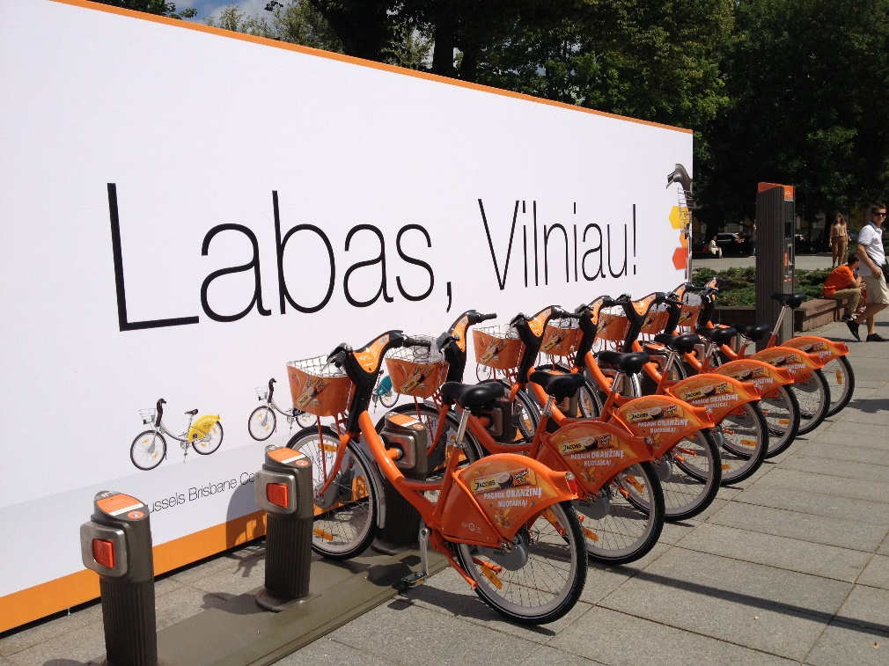
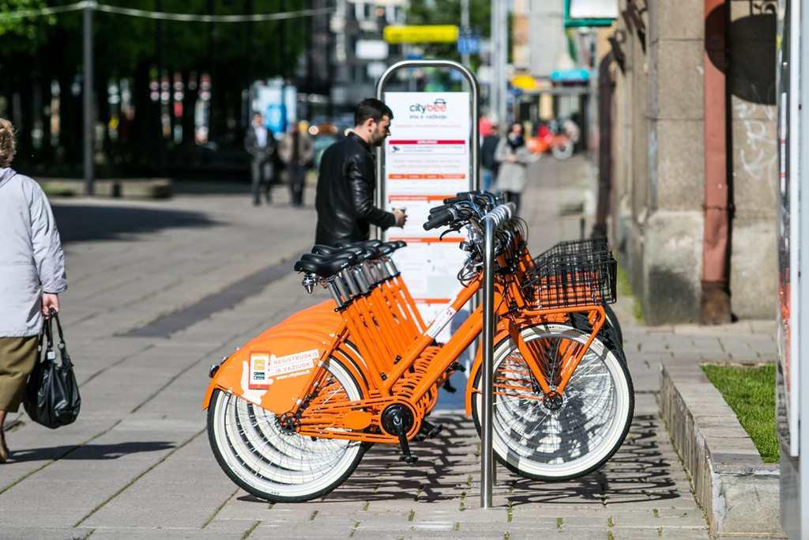
Prices
Cyclocity and CityBee prices:
12 months - 19,90 EUR, for youth (14-26 years old) - 13,90 EUR;
30 days - 3,90 EUR;
3 days 2,90 EUR;
Despite of which type of membership you have, every firs 30 minutes of a trip are free. After that, the traveling is charged by appropriate tariff: the second 30 min costs 0,39 EUR, third - 1,39 EUR, fourth and later - 3,39 EUR.

Slide 10
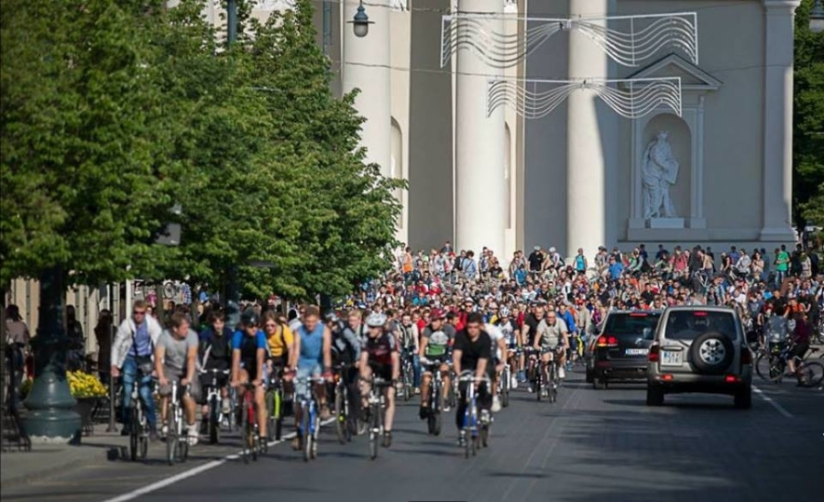
Critical Mass (cycling)
Critical Mass is a cycling event typically held on the last Friday of every month; its purpose is not usually formalized beyond the direct action of meeting at a set location and time and traveling as a group through city or town streets on bikes.
Critical Mass has been described as "monthly political-protest rides", and characterized as being part of a social movement. It has been described as a "monthly protest by cyclists reclaiming the streets.

