Slide 1
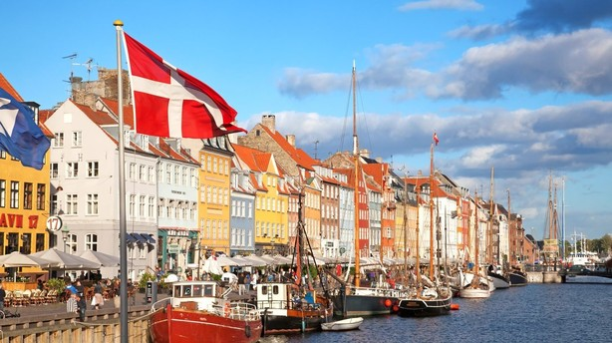
Denmark
A presentation by the Danish delegation:
Notes:
Presentation of Denmark
3 parts: PowerPoint presentation and then 2 parts of interaction ☺
Please feel free to ask questions when the entire presentation is finished.
The picture is from Nyhavn, a sunny tourist attraction by the harbour in Copenhagen.

Slide 2
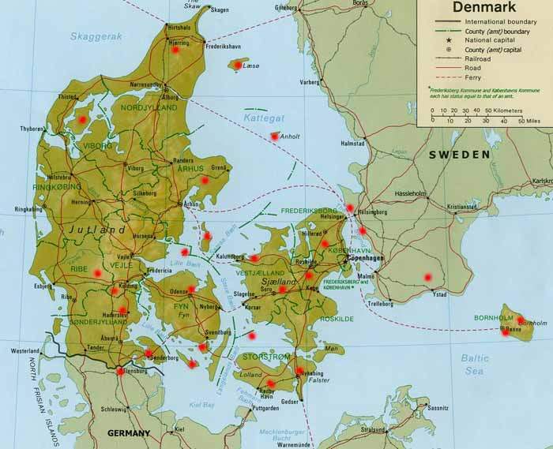
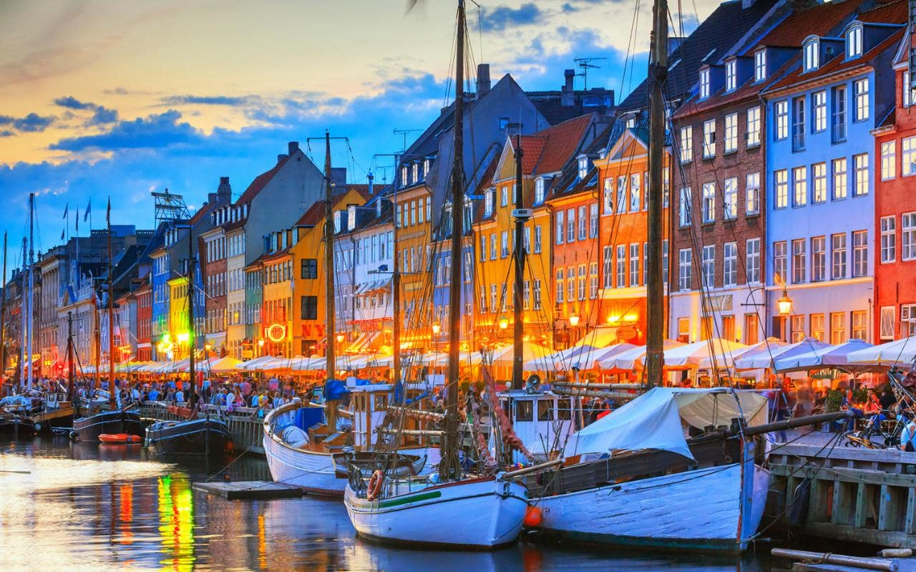
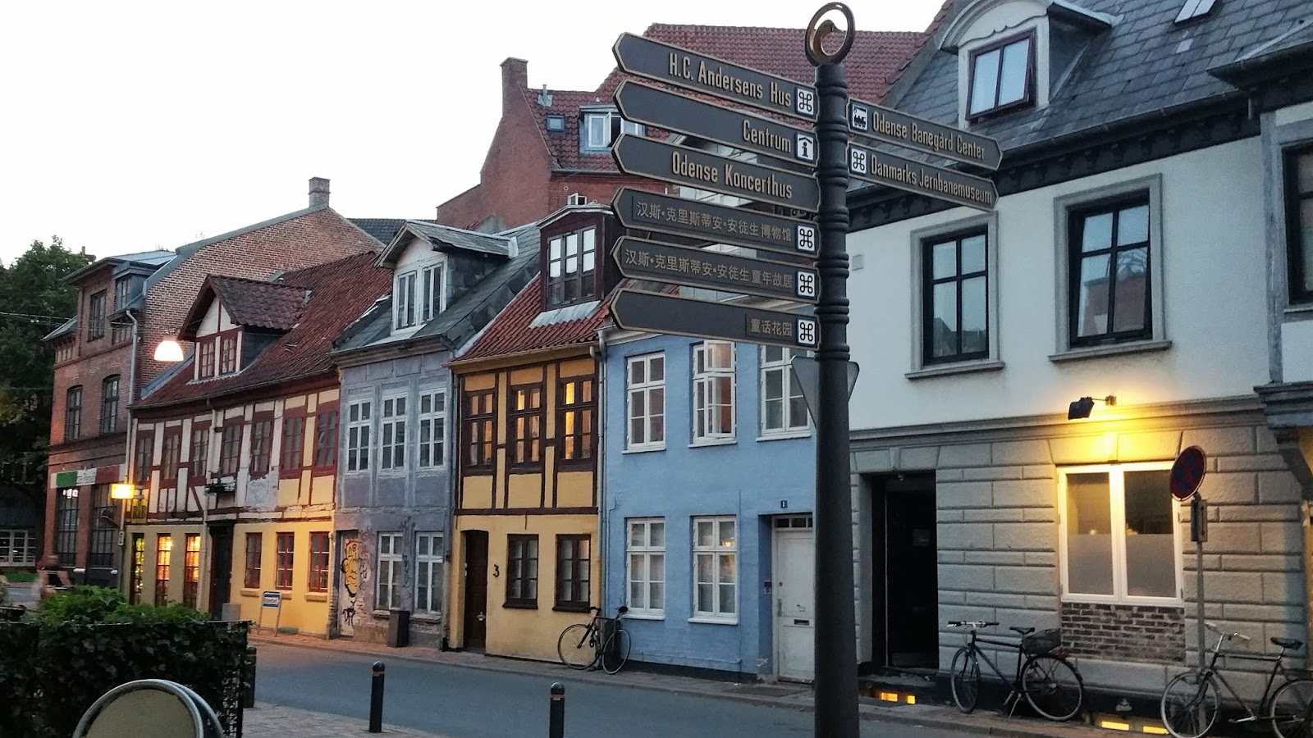
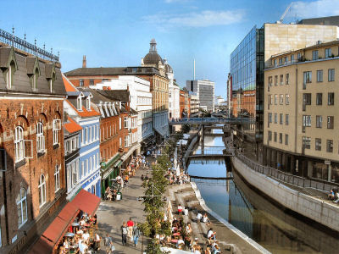
Where we are from:

Slide 3
Short facts
6 million people (43.000 km²)
The capital is Copenhagen
Constitutional monarchy (Queen Margrethe)
Highest point: Ejer Bavnehøj (172 m)
Birth rate 1,69 children on average
Source: CIA World Factbook
Notes:
We are located in Northern Europe, in Scandinavia: Neighboring countries are Sweden, Norway, Iceland and Germany.
Copenhagen: 1,2 million people including the greater Copenhagen area
Monarchy includes the Faroe Islands and Greenland
Flat country
Highest percentage of arable land i the world
World-leading firms in pharmaceuticals, maritime shipping and renewable energy
Generally considered as one of the richest countries in the world (considered the size)
Four seasons and a lot of wind and rain ☺
Election on June 18th 2015.

Slide 4
Welfare
Free health care and free education
Trust and solidarity (in theory)
Maternity leave
Six weeks paid vacation
Support from the government when studying or unemployed

Slide 5
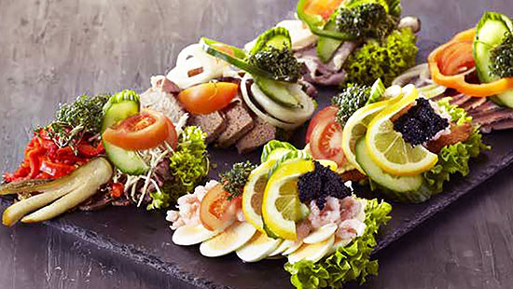
Known for:
LEGO
Carlsberg
Wind Mills
Novo NordiskMedicine industry (diabetes)
Architecture and design
Jamie Lannister
Christiania
Open sandwiches(smørrebrød)

Slide 6
Sports
Nationalsport: Football (Euro 1992 in Sweden)
Handball (European champions)
Rowing (Worldchampions and Olympic gold)
Icehockey
Golf,
Tabletennis
badminton
curling
bikecycling
Sailing
Tennis
Notes:
Dansk Handicap IdrætsForbund (The National Paralympic Commitee) has approximately 400 member clubs with approximateley 12.400 members.

Slide 7
Quiz time
Danes eat and export a lot of pork. How many pigs are there in DK?
15 mil
23 mil
29 mil
2. Denmark was in 2013 and 2014 known as the
the flattest country in the world?
the happiest country in the world?
the most beer consuming country in the world?
Notes:
Danes eat and import a lot of pork. How many pigs are there in DK? (correct answer= approx. 12,5 million)
Picture quiz: PH, Victor Borge or King
Denmark was in 2013 and 2014 know as the
the flattest country in the world?
the happiest country in the world? –Correct answer
the most beer consuming country in the world?
1 out 5 Danes...
supports the possibility of having capital punishment? – Correct answer
is diagnosed with cancer? – 1 out of 3
believes society needs more camera surveillance? 1 out of 2
How many of the people in the capital, Copenhagen, ride their bike to work?
Approx. 30 percent?
Approx. 50 percent? – Correct answer
Approx. 70 percent?

Slide 8
Quiz time
3. 1 out 5 Danes...
supports the possibility of having death penalty?
is diagnosed with cancer?
believes society needs more camera surveillance?
Notes:
Danes eat and import a lot of pork. How many pigs are there in DK? (correct answer= approx. 12,5 million)
Picture quiz: PH, Victor Borge or King
Denmark was in 2013 and 2014 know as the
the flattest country in the world?
the happiest country in the world? –Correct answer
the most beer consuming country in the world?
1 out 5 Danes...
supports the possibility of having capital punishment? – Correct answer
is diagnosed with cancer? – 1 out of 3
believes society needs more camera surveillance? 1 out of 2
How many of the people in the capital, Copenhagen, ride their bike to work?
Approx. 30 percent?
Approx. 50 percent? – Correct answer
Approx. 70 percent?

Slide 9
Quiz time
How old do you have to be to buy alcohol?
16 years old
17 years old
18 years old
Denmark was the first country to free porn, what year was that?
1969
1973
1981
Notes:
Danes eat and import a lot of pork. How many pigs are there in DK? (correct answer= approx. 12,5 million)
Picture quiz: PH, Victor Borge or King
Denmark was in 2013 and 2014 know as the
the flattest country in the world?
the happiest country in the world? –Correct answer
the most beer consuming country in the world?
1 out 5 Danes...
supports the possibility of having capital punishment? – Correct answer
is diagnosed with cancer? – 1 out of 3
believes society needs more camera surveillance? 1 out of 2
How many of the people in the capital, Copenhagen, ride their bike to work?
Approx. 30 percent?
Approx. 50 percent? – Correct answer
Approx. 70 percent?

Slide 10
Quiz time
6. How many of the people in the capital, Copenhagen, ride their bike to work?
Approx. 30 percent?
Approx. 50 percent?
Approx. 70 percent?
7. How many kg of candy does the average Dane eat pr. Year?
5 kg
8 kg
12 kg
Notes:
Danes eat and import a lot of pork. How many pigs are there in DK? (correct answer= approx. 12,5 million)
Picture quiz: PH, Victor Borge or King
Denmark was in 2013 and 2014 know as the
the flattest country in the world?
the happiest country in the world? –Correct answer
the most beer consuming country in the world?
1 out 5 Danes...
supports the possibility of having capital punishment? – Correct answer
is diagnosed with cancer? – 1 out of 3
believes society needs more camera surveillance? 1 out of 2
How many of the people in the capital, Copenhagen, ride their bike to work?
Approx. 30 percent?
Approx. 50 percent? – Correct answer
Approx. 70 percent?

