Slide 1

Current knowledge assessment
23rd October 2017

Slide 2
How do we understand “Bicycle“? ☺
Transport for cycling;
Two wheels;
Something biological as we use our body to do it;
You create power to receive power;
Freedom;
Way to live, to think, to travel without barriers;
Single- or multi-track vehicle not wider than 90 cm and not longer than 400 cm, powered with rider's muscle strength, minor electric engine support is allowed;
Bicycle is like = Be like be, Cycle like full, happy, complete, funcional etc.

Slide 3
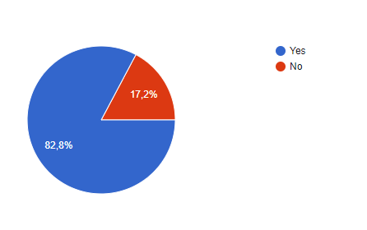
Do we own a bicycle?

Slide 4
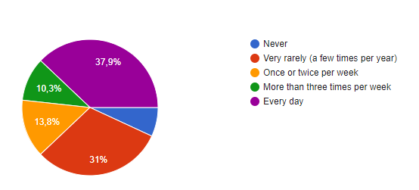
How often do we ride a bicycle?

Slide 5
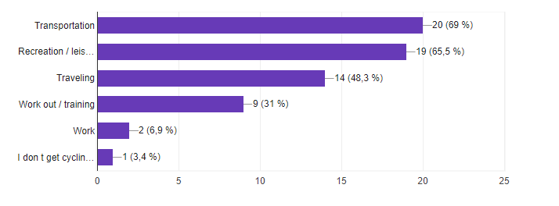
Why do we use it?

Slide 6
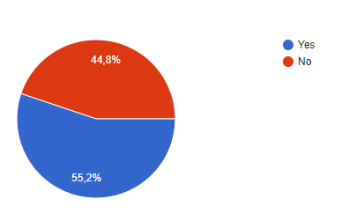
Have we ever used bicycle rental services?

Slide 7
Where?
While travelling (lots of different countries…)
And at home as a public transport to reach places.
Experience at managing bike rental system!

Slide 8
What are the main advantages of cycling in the city?
Free of charges/cheap;
Independence (you are the one controlling the time);
No traffic;
It’s fun;
It’s healthy/good physical condition;
Environmental/saves our planet!

Slide 9
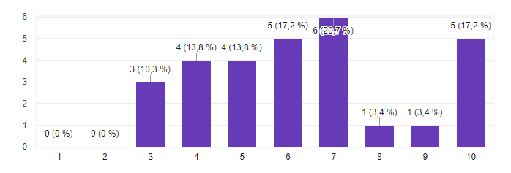
Is it popular?

Slide 10
What are the challenges for the bicyclists?
Weather (no shower at the work place);
Infrastructure (bad roads, stolen bikes, no parking);
Technical problems with bikes (no brakes, no lights, no place for luggage);
Mentality of the country (no biking culture; angry drivers);
Lack of political will (outdated laws).

Slide 11
Good practices around Europe
Birmingham Cycling Revolution
Bike pride
150 cm
"Rowerowy Maj"

Slide 12
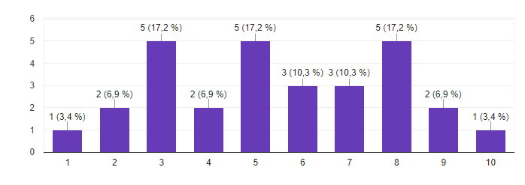
How much do we know about cycling?

Slide 13
How much we will know after a week in Kaunas?
As much as we share all together! Enjoy.

