Slide 1
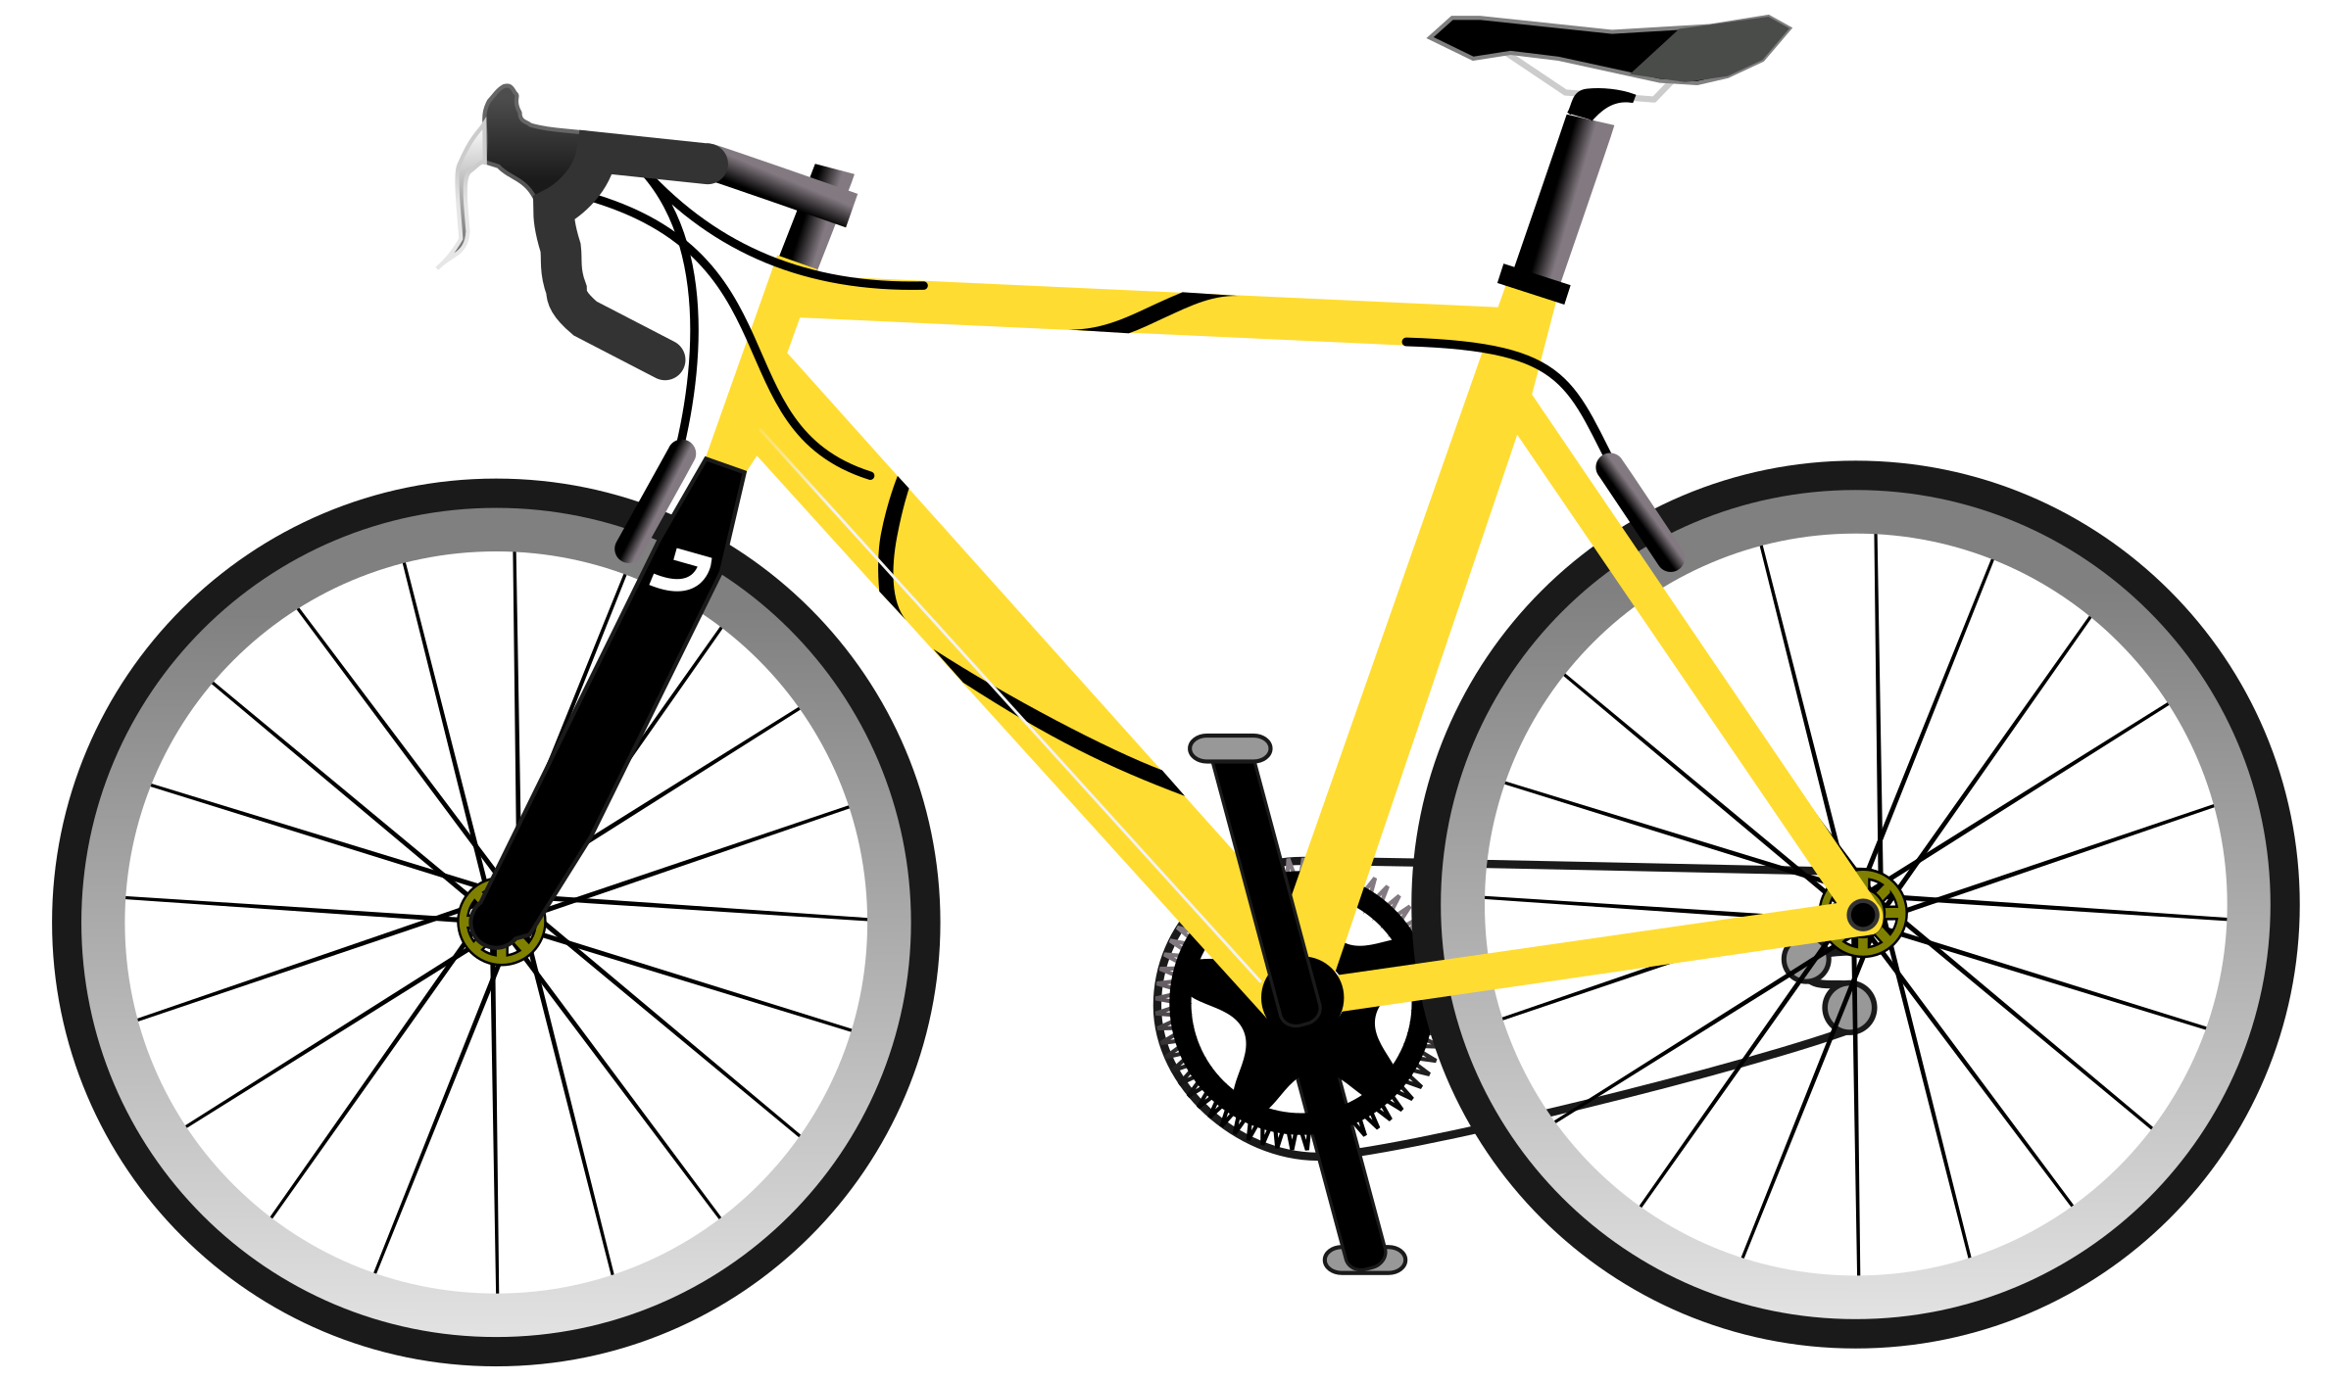

Cycle and the City
INFO SESSION

Slide 2

THE HISTORY…
Do you when the first bicycle was made?
Who invented it?
How did it look like?

Slide 3
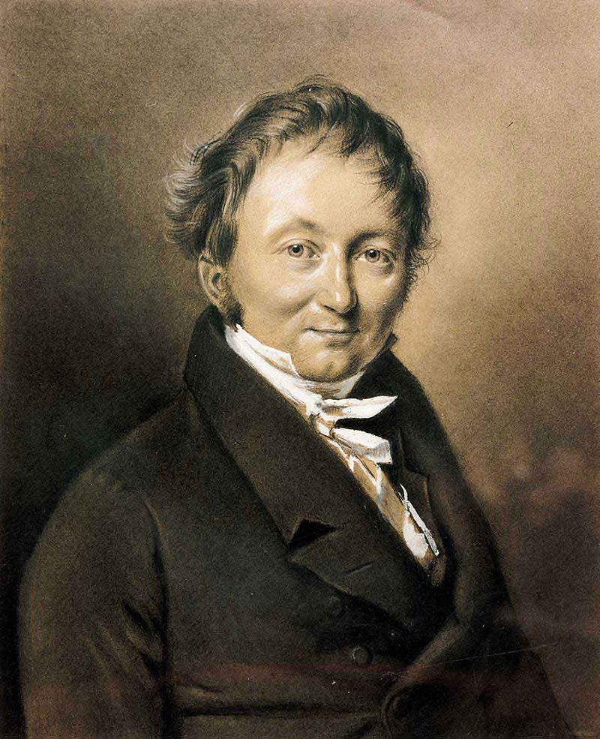
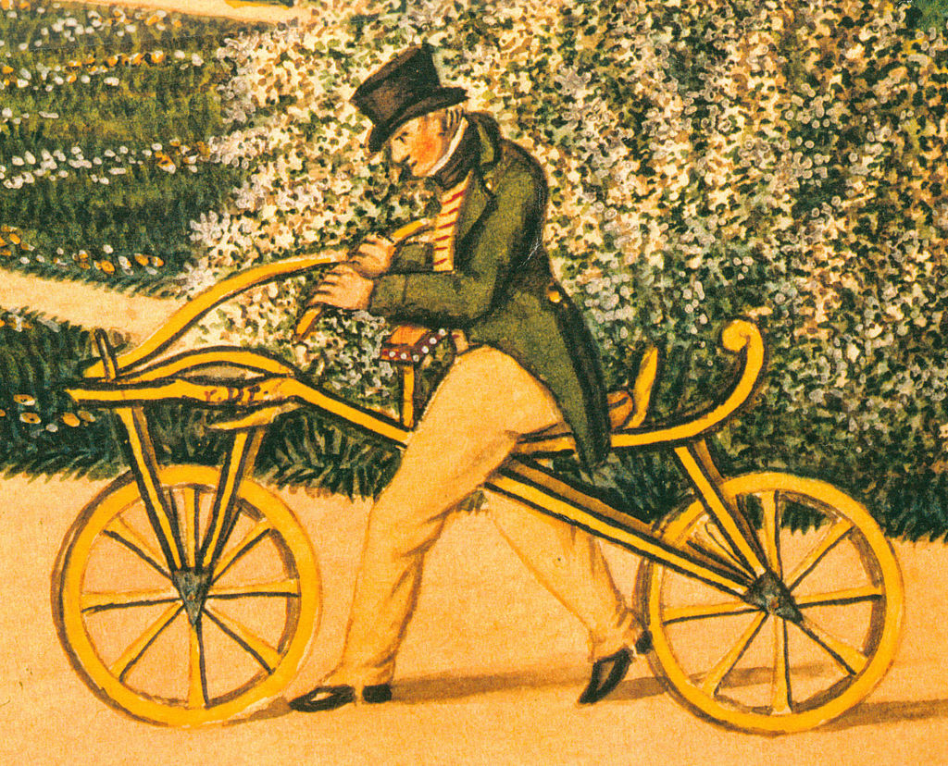
THE FIRST BICYCLE - LAUFMASCHINE
Mannheim, 1817
German aristocrat and inventor Karl von Drais

Slide 4
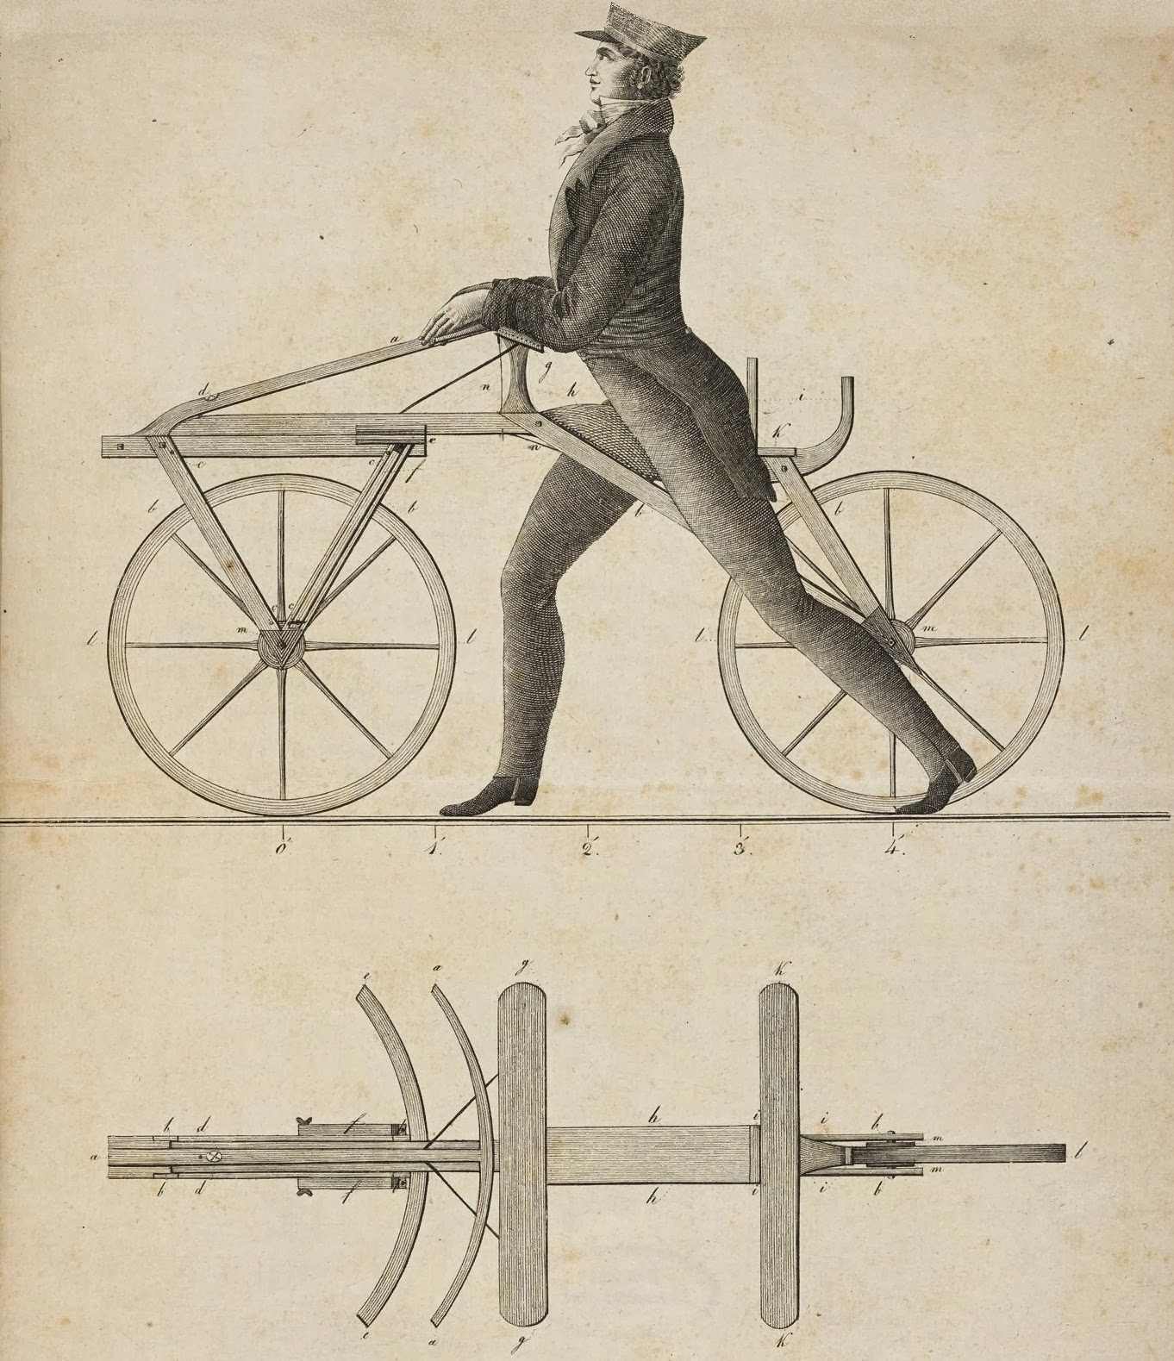
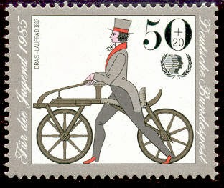
Two wooden wheels attached to a wooden frame
No gears, no pedals
Weight – 23 kg
Notes:
Weighing in at 5e. 0 lbs. (23 kilograms), this bicycle ancestor featured two wooden wheels attached to a wooden frame. Riders sat on an upholstered leather saddle nailed to the frame and steered the vehicle with a rudimentary set of wooden handlebars. There were no gears and no pedals, as riders simply pushed the device forward with their feet.
Drais took his invention to France and to England, where it became popular. A British coach maker named Denis Johnson marketed his own version, called "pedestrian curricles," to London's pleasure-seeking aristocrats. Hobby horses enjoyed several years of success before they were banned from sidewalks as a danger to pedestrians. The fad passed, and by the 1820s, the vehicles were rarely seen, according to the National Museum of American History (NMAH).

Slide 5
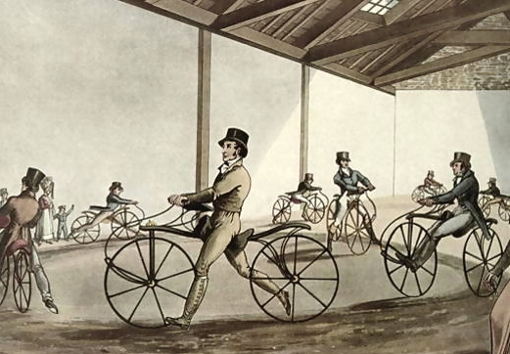
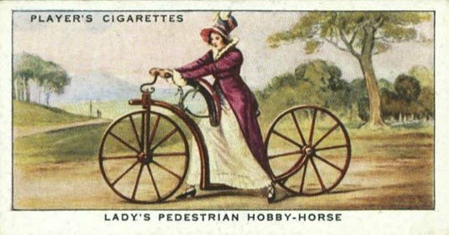
pedestrian curricles
OR
HOBBY-HORSES
* Curricle - a two-wheeled open carriage drawn by two horses side by side

Slide 6
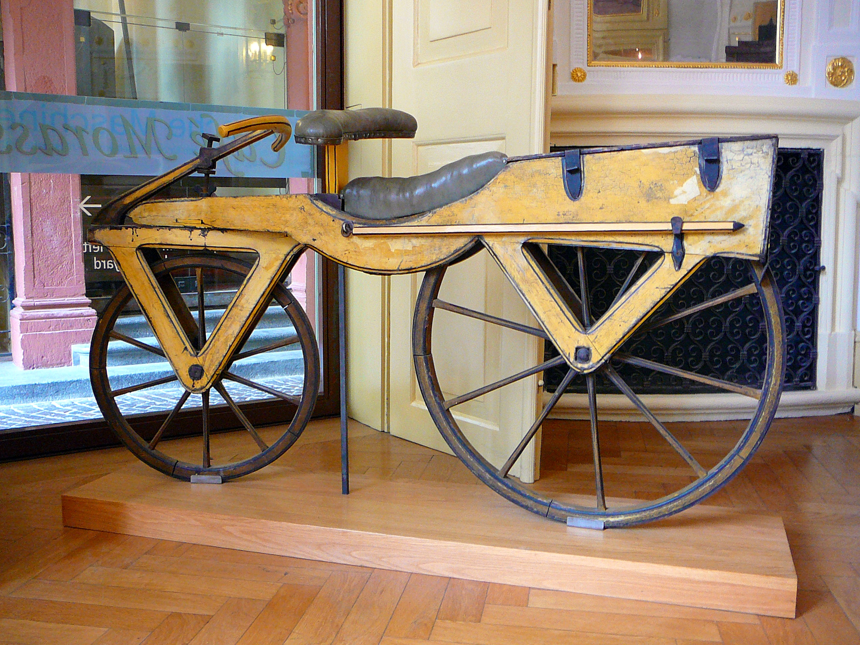
The Kurpfälzisches Museum
Heidelberg, Germany

Slide 7

1815 – Mount Tambora in Indonesia erupted
1816 – Year Without a Summer
Notes:
Drais built his machine in response to a very serious problem — a dearth of real horses. In 1815, Mount Tambora, in Indonesia, erupted and the ash cloud dispersed around the world a lowered global temperatures. Crops failed and animals, including horses, died of starvation.

Slide 8
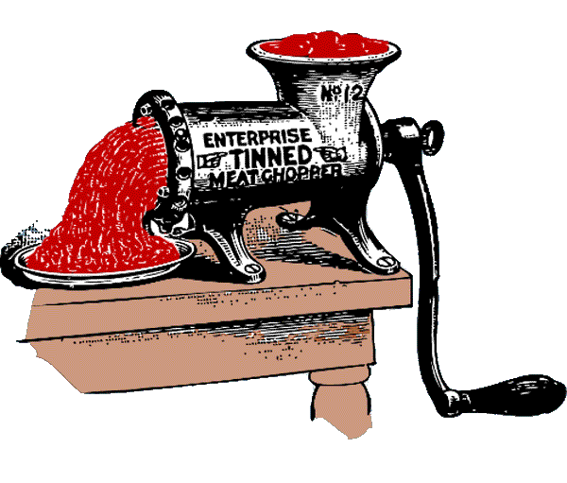
RANDOM FACT
Karl von Drais also invented
the first meat grinder…

Slide 9
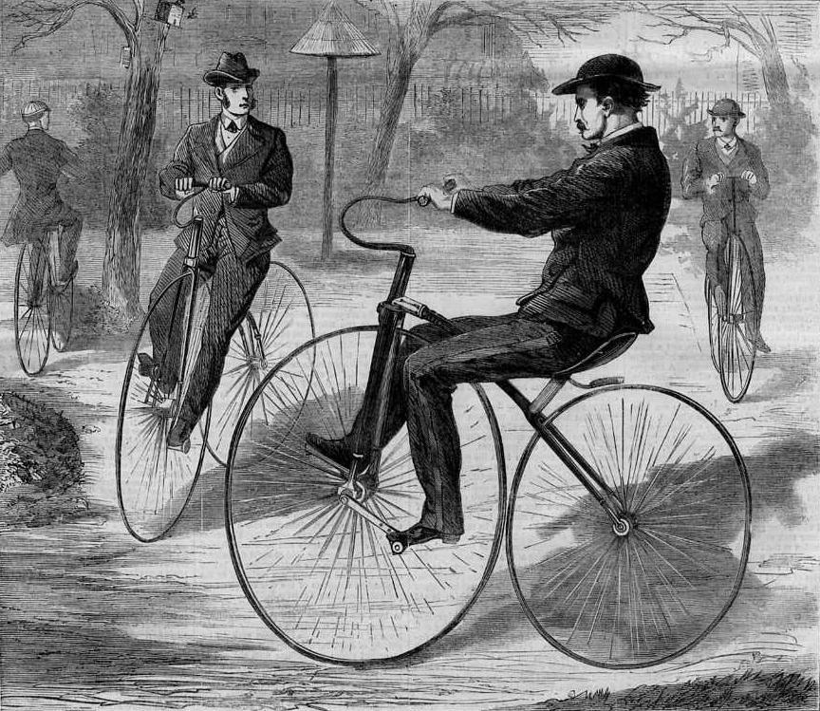
VELOCIPEDE -“Boneshaker”
France, 1860s
First type of true bicycle with pedals
Rigid frame and iron-banded wheels
Notes:
which was called velocipede by its manufacturers. "" refers to the extremely uncomfortable ride, which was caused by the stiff wrought-iron frame and wooden wheelssurrounded by tires made of iron.

Slide 10
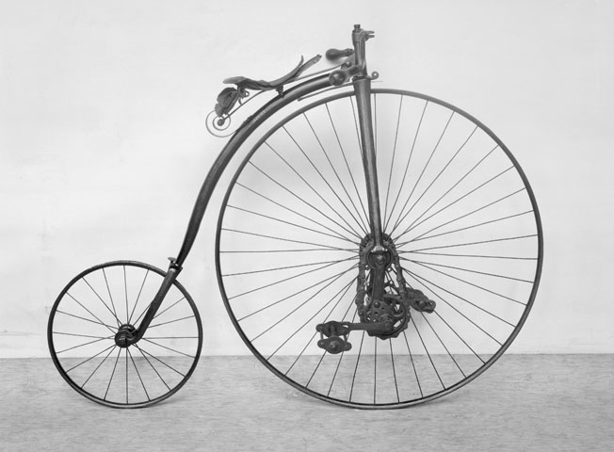
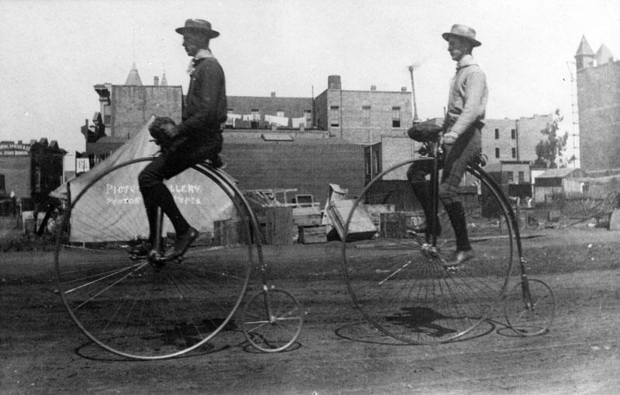
Penny-farthing
France, 1870s
The first machine to be called a "bicycle”

Slide 11
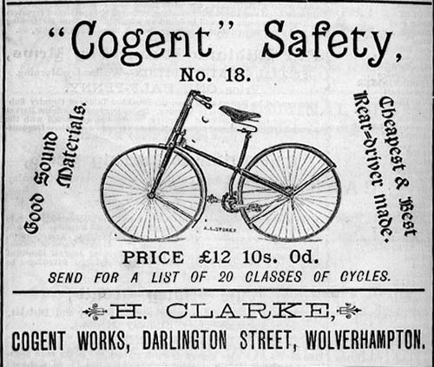
SAFETY BICYCLE
England, 1885
Unlike with penny-farthings, the rider's feet were within reach of the ground, making it easier to stop
The pedals powered the rear wheel, keeping the rider's feet safely away from the front wheel

Slide 12
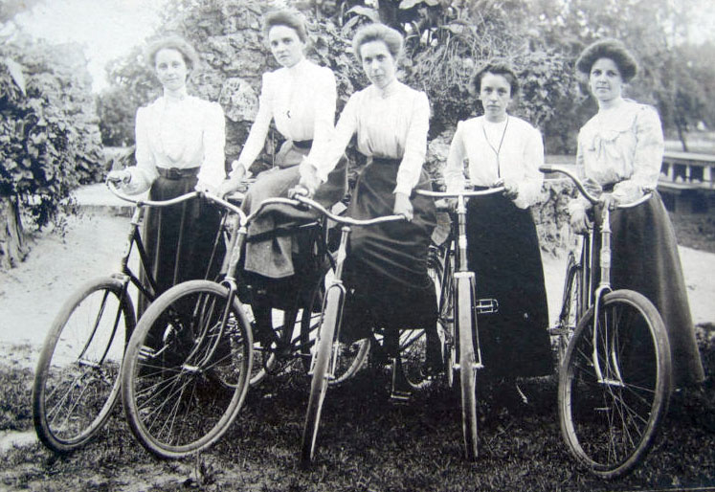
FREEDOM MACHINE
“Let me tell you what I think of bicycling. I think it has done more to emancipate women than anything else in the world. It gives women a feeling of freedom and self-reliance. I stand and rejoice every time I see a woman ride by on a wheel…the picture of free, untrammeled womanhood.”
Susan B. Anthony
Notes:
As women learned to ride bicycles they not only gained physical mobility that broadened their horizons beyond the neighborhoods in which they lived, they discovered a new-found sense of freedom of movement, a freedom previously circumscribed by the cumbersome fashions of the Victorian era as well as by Victorian sensibilities. The restrictive clothing of the era -- corsets, long, heavy, multi-layered skirts worn over petticoats or hoop, and long sleeved shirts with high collars -- inhibited freedom of movement and seemed to symbolize the constricted lives women of the 1890s were expected to lead. Such clothing was inimical to even modest forms of exercise or exertion. Cycling required a more practical, rational form of dress, and large billowing skirts and corsets started to give way to bloomers -- baggy trousers, sometimes called a divided skirt, cinched at the knee.

Slide 13


Slide 14
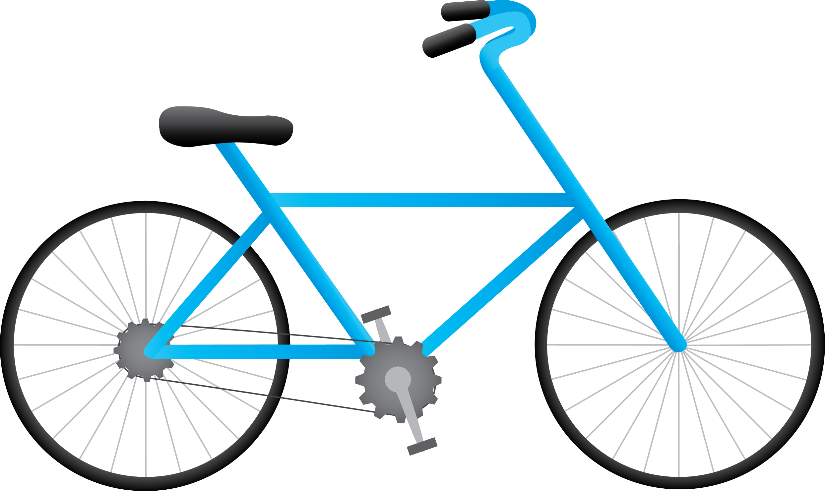
How many bicycles there are in the world?
http://www.worldometers.info/bicycles/
ECF Cycling Barometer 2015
https://ecf.com/resources/photo-gallery/set/72157650698796314
2016 road safety statistics:
What is behind the figures?
http://europa.eu/rapid/press-release_MEMO-17-675_en.htm

Slide 15
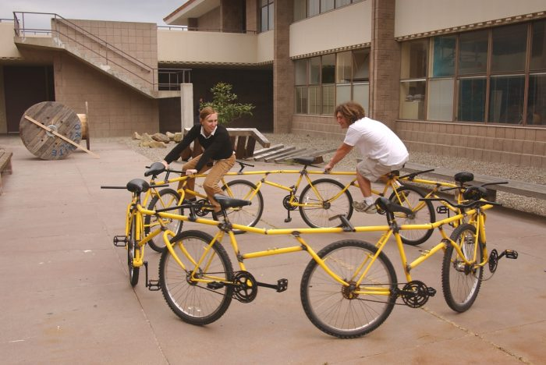
CRAZY BIKES!
https://www.youtube.com/watch?v=fGS2SgiLG80
https://www.youtube.com/watch?v=lNVXSS81APg

