Slide 1
Pub quiz
WMB, 2017

Slide 2

Rules
1 min / question, unless stated otherwise
1 answer = 1pt, unless stated otherwise
Google = -1pt

Slide 3
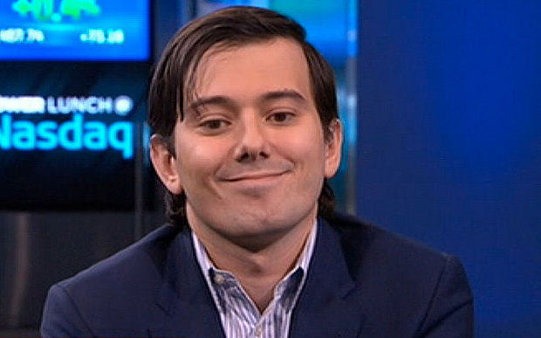
1: Who is this guy? (1pt)

Slide 4
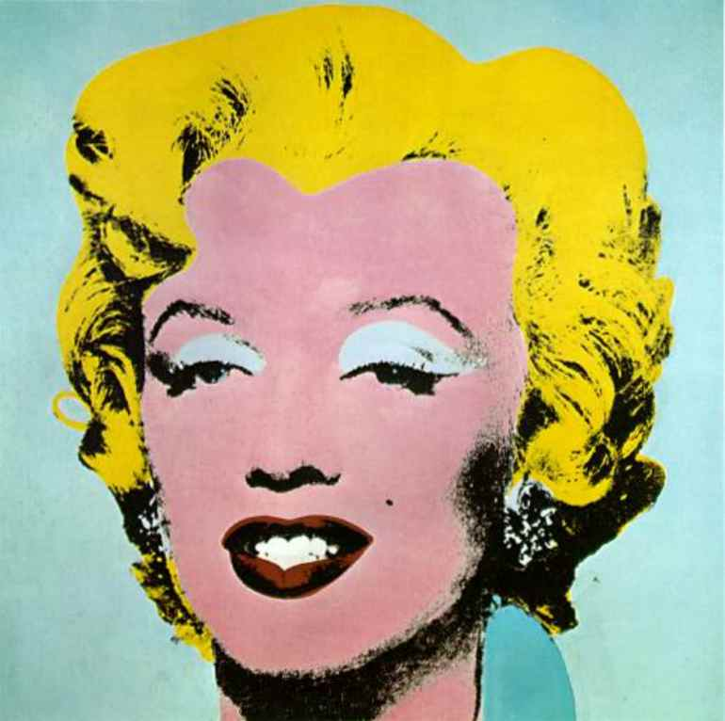
2: Who’s art is this? (1pt)

Slide 5
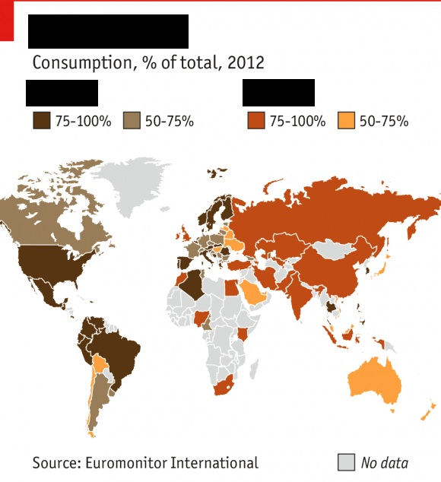
3: What beverages? (0.5pt + 0.5pt)
The map shows usage of 2 types of beverages across the world. What kind of beverages? Corresponding colour should be in the answer
Brown –
Red/orange –

Slide 6
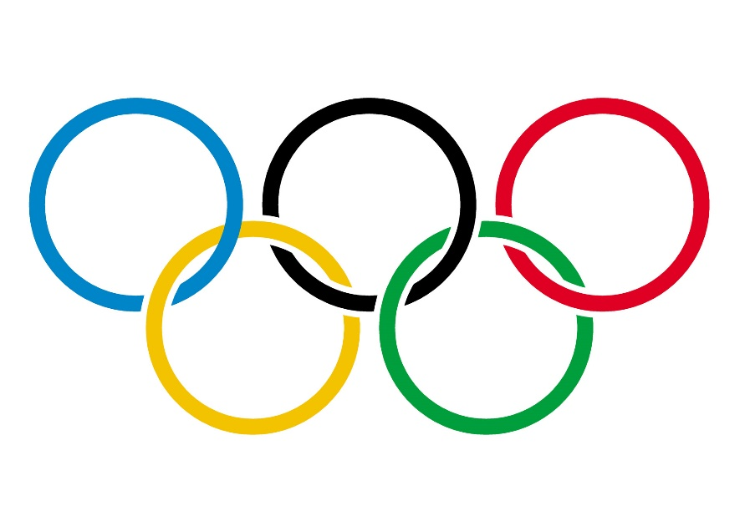
4: Name the hosting cities of the Olympics (1 pt – 1st 4 have to be right)
2004 –
2008 –
2012 –
2016 –
Extra 0.5 pt:
2020 –

Slide 7
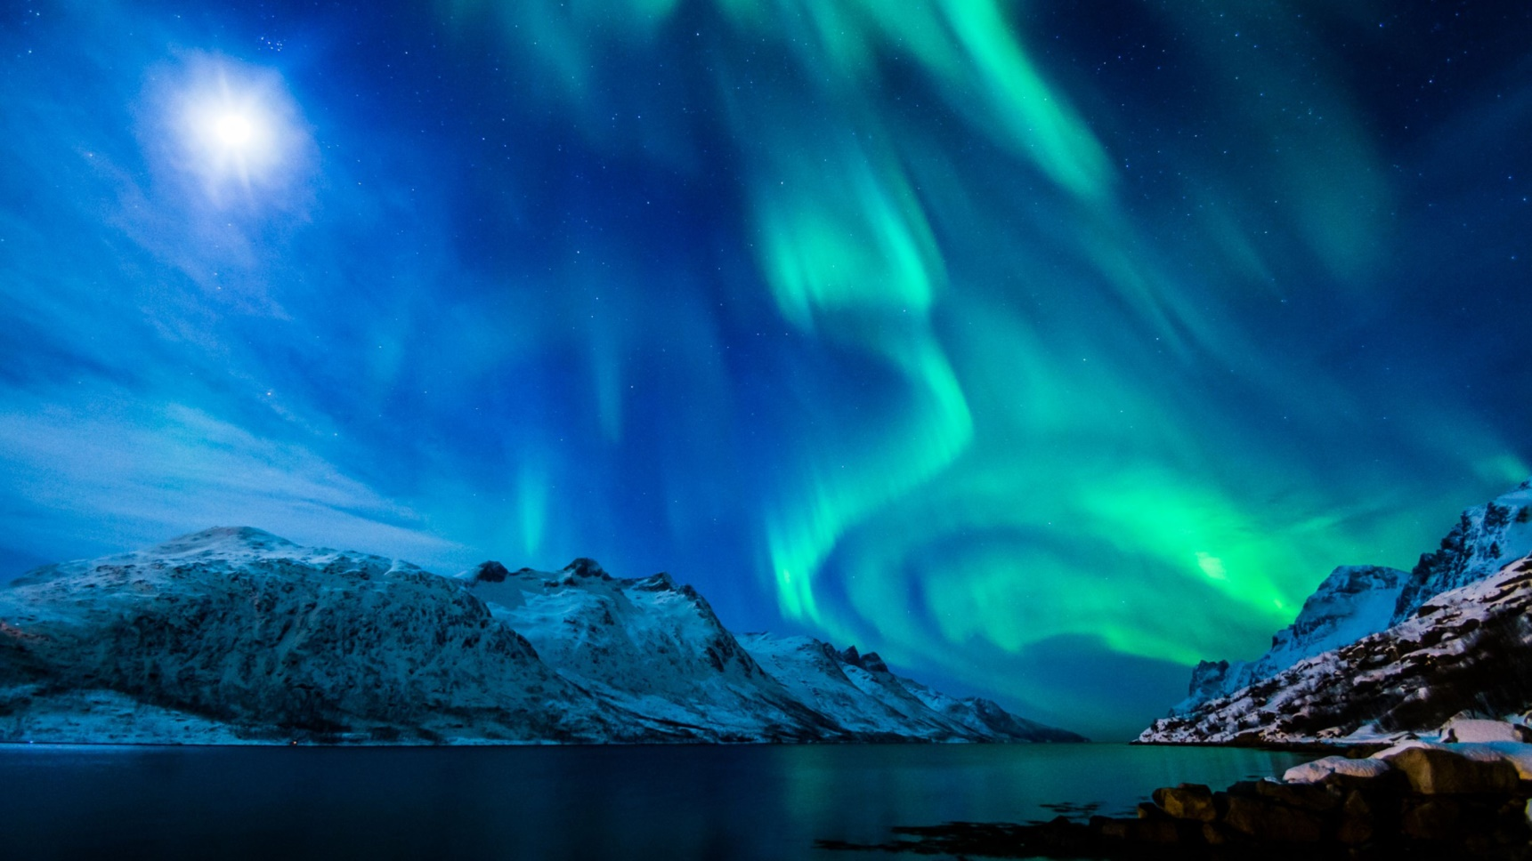
5: Name of the astronomical phenomena. Why does it happen?(1+1pt)

Slide 8
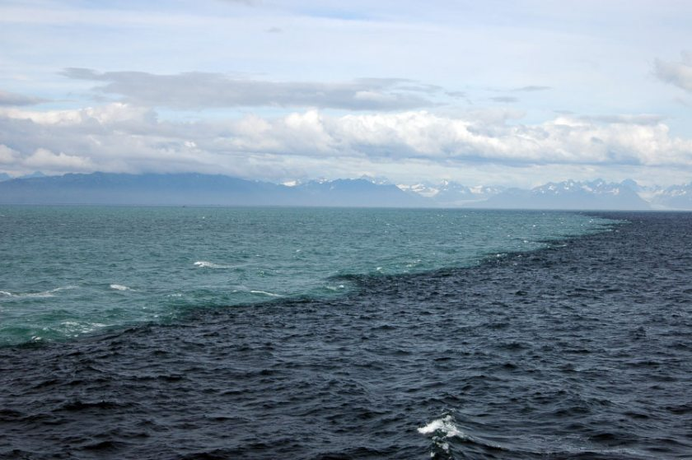
6: How does this happen? (1pt)

Slide 9
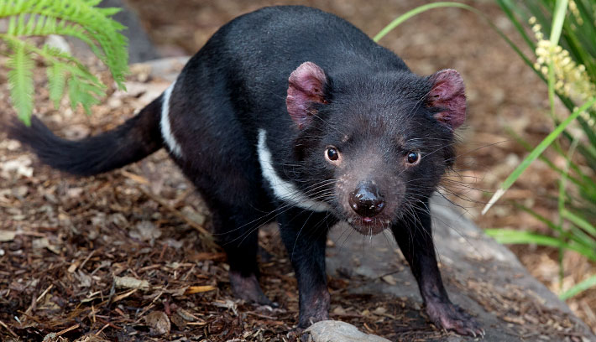
7: Name of the animal? Where does it live? (0.5+0.5pt)

Slide 10
8: Women in Saudi Arabia (1pt)
can:
Swim/take a dip (not in private areas)
Leave the house without a leading person
Be/get elected
Drive

Slide 11

9: according to the Chinese calendar, the symbol of year 2017 is? (1pt)

Slide 12

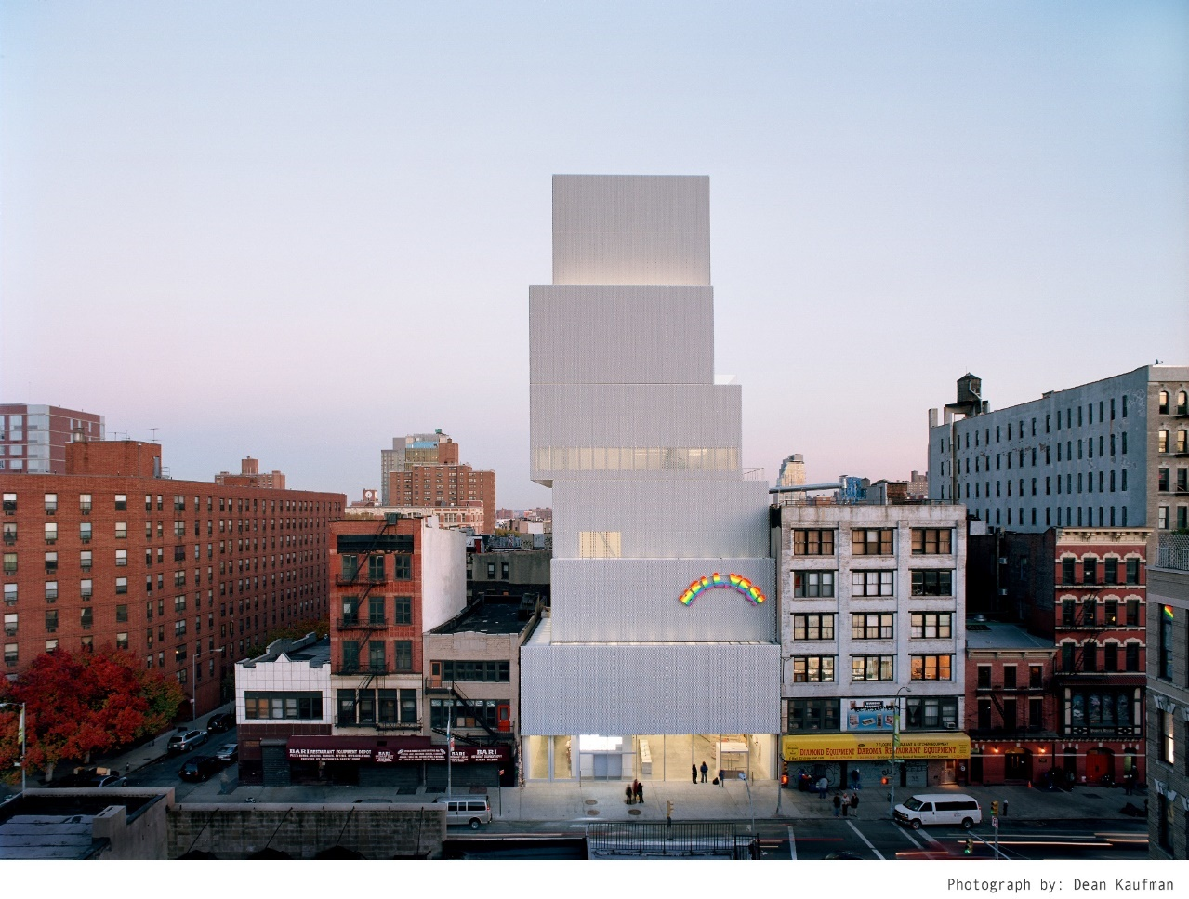
10. In what city can this happy building be found? (1pt)

Slide 13
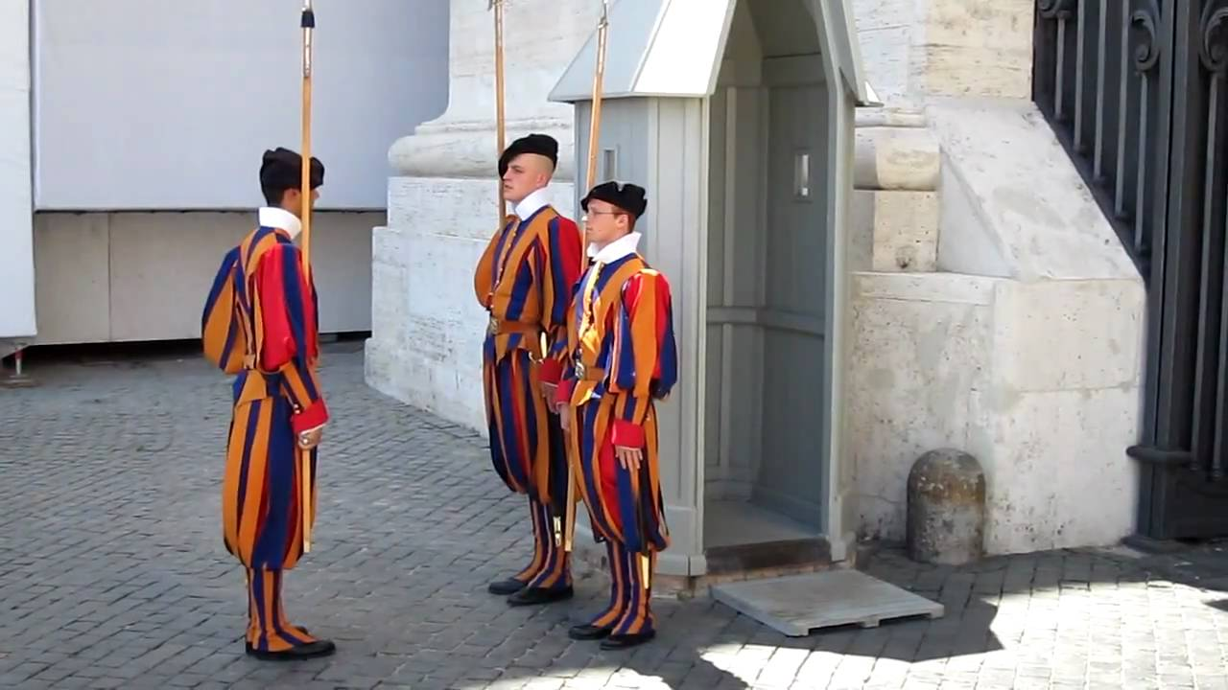
11. Who are these guys? Who can become one? (0.5 + 0.5pt)

Slide 14
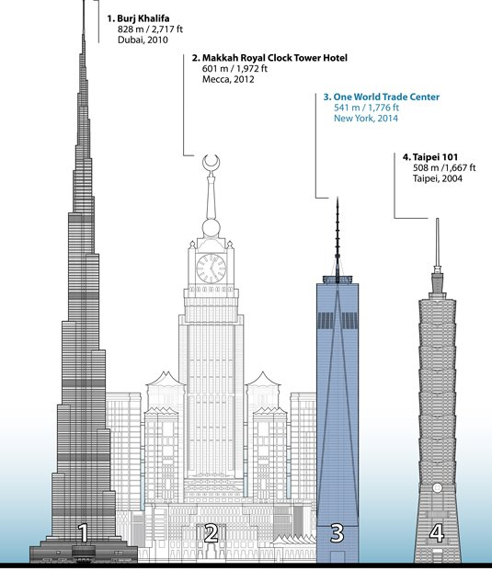
12. Can you name the locations (country or city) of 4 tallest buildings in the world? (0.5p each)
1)
2)
3)
4)

Slide 15
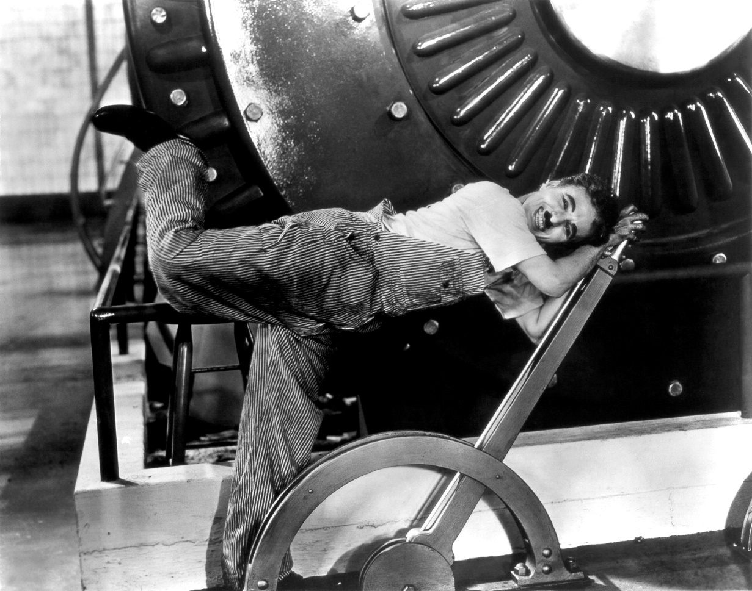
13. How is this C. Chaplin’s world famous movie called? (1p)

Slide 16
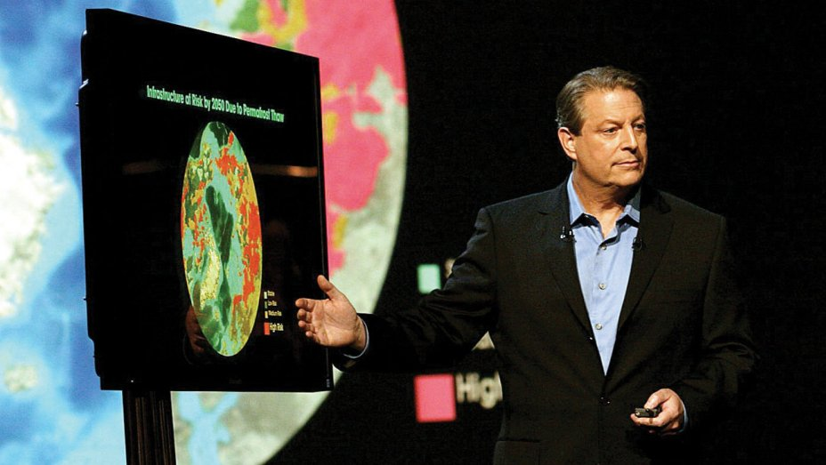
14. Name this well-known 2006 docummentary of A.Gore about global warming (1pt)

Slide 17
Musical Questions
Each correct answer gives you 1 point in total:
  0.5 point for the singer/band/composer;
  And another 0.5 – for the name/title of the song/track.
Using Shazam or similar applications = -1 point

Slide 18
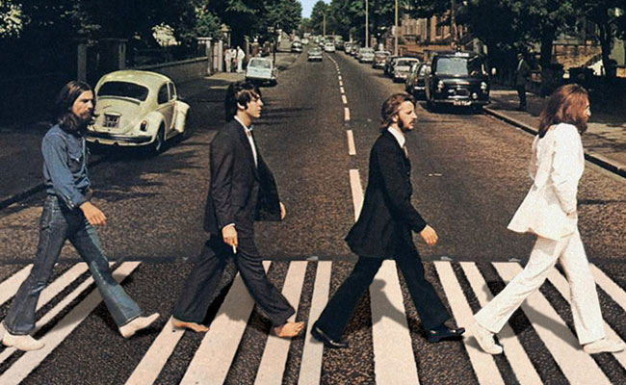
15. Name the Beatles (1pt if all are correct)

Slide 19
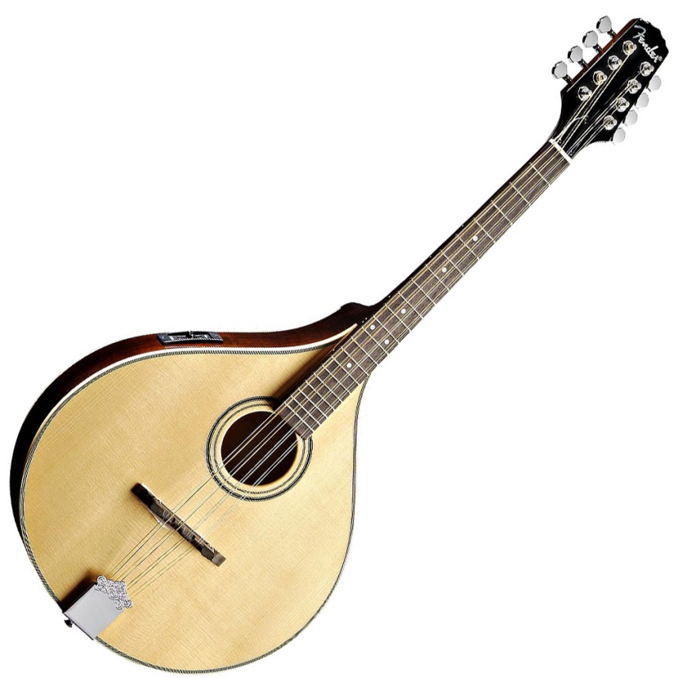
16: Name this musical instrument, and the country it originates from
(0.5+0.5pt)

Slide 20

17. Song 1

Slide 21
18. Song 2

Slide 22
19. Song 3

Slide 23
20. Song 4

Slide 24
21. Song 5

Slide 25
Extra 30s questions
0.5 point each

Slide 26
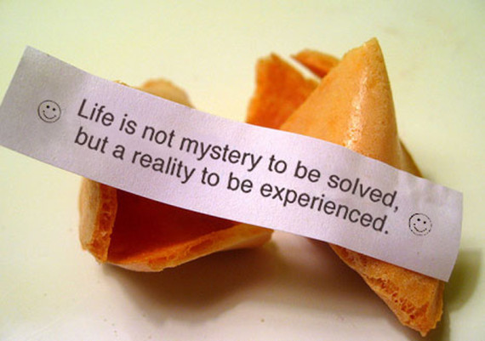
22: Where were the fortune cookies invented?
A. Guangzhou, China
B. Kyoto, Japan
C. San Francisco, USA
D. Quebec City, Canada

Slide 27
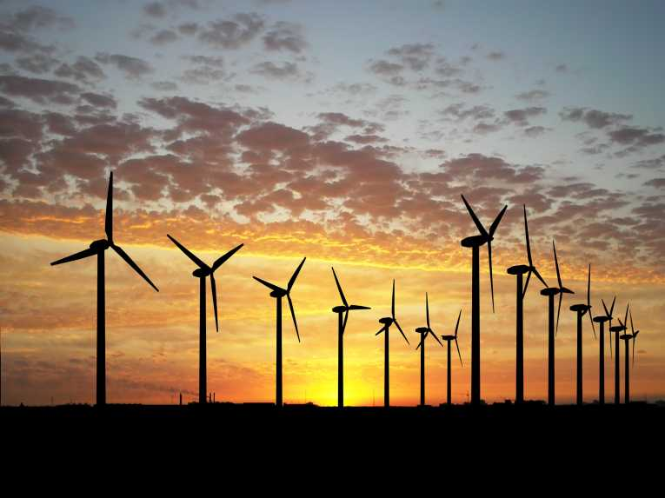
23: Which country has the most installed windpower capacity? (0.5pt)
A. United States of America
B. China
C. The Netherlands
D. Germany

Slide 28
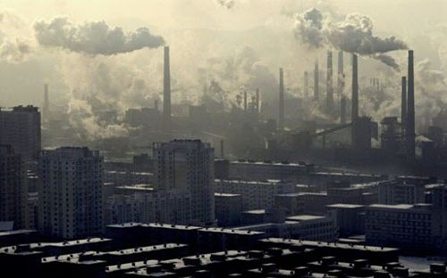
24. What is the most polluted city in the world? (0,5 p)
A. Los Angeles, California
B. City, Mexico
C. New Dehli, India
D. Shanghai, China

Slide 29
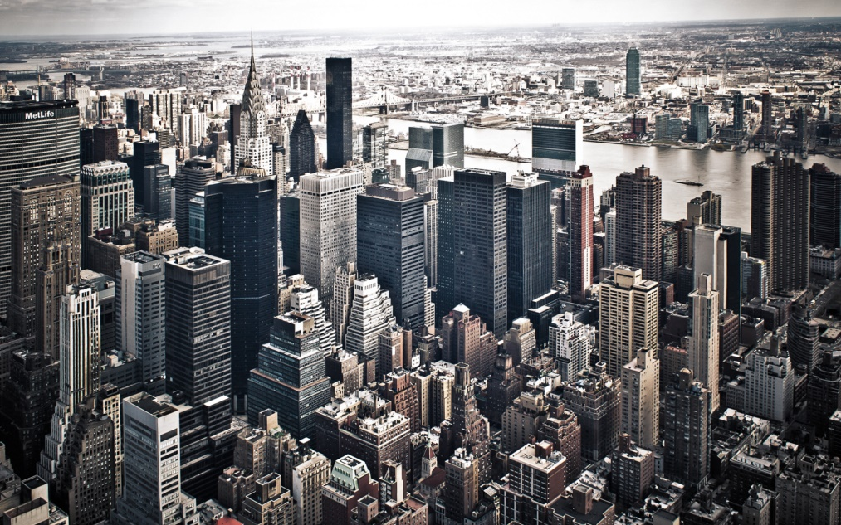
25. Which country consumes the most energy in the world? (0.5p)
A. Russia
B. China
C. The United States
D. Canada

Slide 30
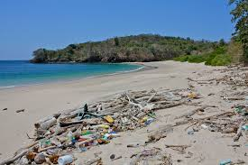
26. What is the most common litter found on beaches? (0.5p)
A. Plastic
B. Aluminum
C. Glass
D. Cigarettes

Slide 31
The End
Now you have few minutes to check the answers.
Once ready, please hand in the answer sheets to organisers.

Slide 32
Answers
AUG, 2017

Slide 33
1: Most hated man on the web (1pt)
Martin Shkreli
Raised the price for drugs

Slide 34
2: Andy Warhol’s art (1pt)

Slide 35
3: What beverages? (0.5pt + 0.5pt)
The map shows usage of 2 types of beverages across the world. What kind of beverages? Corresponding colour should be in the answer
Brown – Coffee
Red/orange – Tea

Slide 36
4: Name the hosting cities of the Olympics (1 pt – 1st 4 have to be right)
2004 – Athens
2008 – Beijing
2012 – London
2016 – Rio de Janeiro
Extra 0.5 pt:
2020 – Tokyo

Slide 37

5: Name of the astronomical phenomena. Why does it happen?(1+1pt)
The Aurora Borealis (Northern Lights) OR Aurora Australis (Southern Lights) are the result of solar winds entering Earth's atmosphere

Slide 38
6: How does this happen? (1pt)
Phenomenon occurs when heavy, sediment-rich water from glaciers and rivers (light blue) pours into the open ocean (dark blue)

Slide 39
7: Name of the animal? Where does it live? (0.5+0.5pt)
Tasmanian devil
Tasmania state of Australia

Slide 40
8: Women in Saudi Arabia (1pt)
Can:
Swim/take a dip (not in private areas)
Leave the house without a leading person
Be/get elected
Drive

Slide 41

9: according to the Chinese calendar, the symbol of year 2017 is Monkey

Slide 42
10. New York City, Manhattan (1pt)

Slide 43
11. Swiss guards at Vatican. Only unmarried catholic Swiss males can join the ranks (0.5 + 0.5pt)

Slide 44
12. Can you name the locations (country or city) of 4 tallest buildings in the world? (0.5p each)
1) Dubai, UAE
2) Mecca, Saudi Arabia
3) NYC, USA
4) Taipei, Taiwan

Slide 45

13. Charlie Chaplin world-famous movie. (1p)
„Modern Times”, 1936

Slide 46
14. Name the well-known 2006 docummentary about global warming (1p)
„An inconvenient truth”

Slide 47
15. Name the Beatles (1p if all are correct)
George Harrison
Paul MccArtney
Ringo Starr
John Lennon

Slide 48
Q16: Name this musical instrument, and the country it originates from
(0.5+0.5pt)
Mandolin, Italy

Slide 49
Musical Questions
Each correct answer gives you 1 point in total:
  0.5 point for the singer/band/composer;
  And another 0.5 – for the name/title of the song/track.

Slide 50
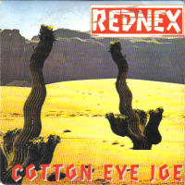
17. (0.5+0.5p)

Slide 51
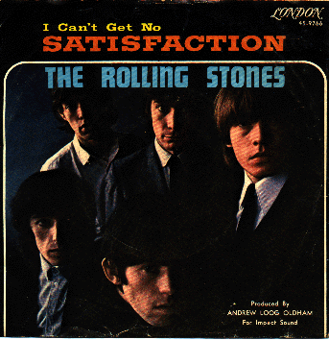
18. (0.5+0.5p)

Slide 52
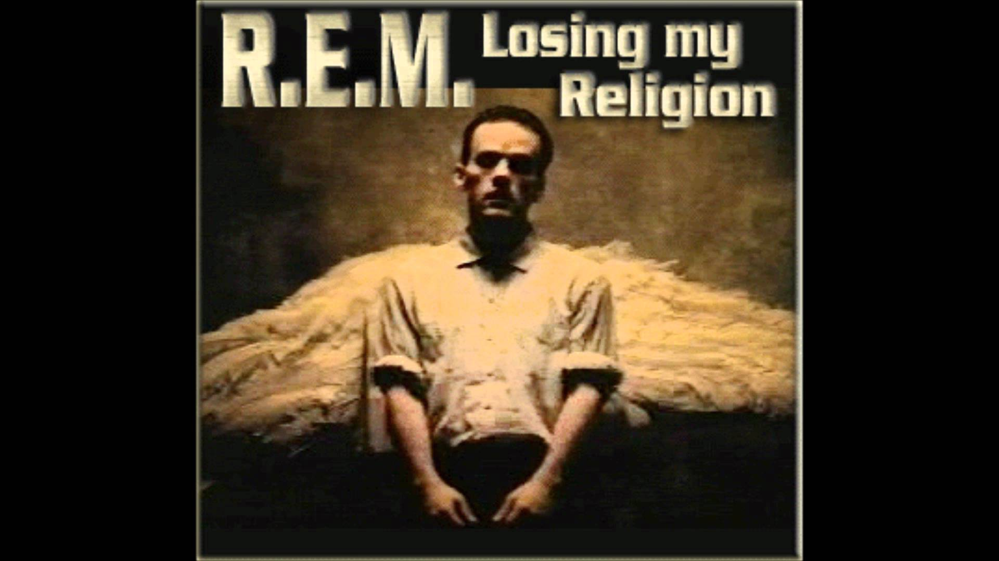
19. (0.5+0.5p)

Slide 53
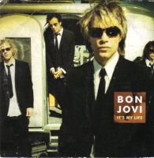
20. (0.5+0.5p)

Slide 54
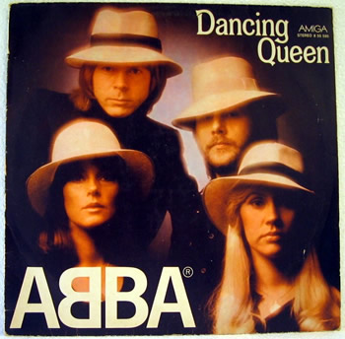
21. (0.5+0.5p)

Slide 55
22: Where were the fortune cookies invented?
A. Guangzhou, China
B. Kyoto, Japan
C. San Francisco, USA
D. Quebec City, Canada
The fortune cookies were made by a San Francisco bakery, Benkyodo.

Slide 56
23: Which country has the most installed windpower capacity? (0.5pt)
A. United States of America
B. China
C. The Netherlands
D. Germany
China: 30,753 MW (48.5%)

Slide 57
24. What is the most polluted city in the world? (0,5 p)
A. Los Angeles, California
B. City, Mexico
C. New Dehli, India
D. Shanghai, China

Slide 58
25. Which country consumes the most energy in the world? (0.5p)
A. Russia
B. China
C. The United States
D. Canada

Slide 59
26. What is the most common litter found on beaches? (0.5p)
A. Plastic
B. Aluminum
C. Glass
D. Cigarettes

Slide 60
The end
Count the points!

