Slide 1
Digital Tools for youth work & volunteering
Let’s Digitalise Youth Organisations
Erasmus+ training course in Kaunas

Slide 2
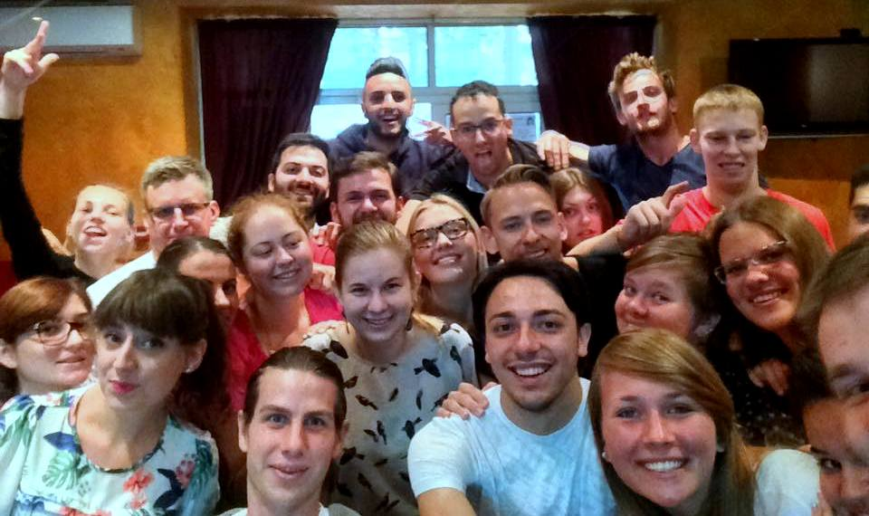
How did you find this training course?

Slide 3
Your organisations on Facebook:
1. Lithuania - https://www.facebook.com/activeyouthlt
2. Latvia - https://www.facebook.com/wearefromlatvia
3. Poland - https://www.facebook.com/4youthpl
4. Italy - https://www.facebook.com/inprogresscalabria
5. Romania - https://www.facebook.com/ATDD.ro

Slide 4

ERASMUS+ https://ec.europa.eu/programmes/erasmus-plus/node_en

Slide 5
Erasmus+ pages on Facebook:
Erasmus+ - https://www.facebook.com/groups/erasmuspluss/
Youth in Action - https://www.facebook.com/groups/erasmusyouth/
Salto Youth Resource centres - https://www.facebook.com/groups/24690615144/
Erasmus+ practitioners - https://www.facebook.com/groups/youthforeuropean/
Erasmus+ partner search - https://www.facebook.com/groups/eramus.plus/
Erasmus Plus Projects - https://www.facebook.com/groups/211479949023086/
Youth Exchange Projects - https://www.facebook.com/groups/292568195178/
Youth Exchanges for Europeans - https://www.facebook.com/groups/youthforeuropean/
Youth Projects YiA - https://www.facebook.com/groups/yia18/
...some more?

Slide 6

Salto-youth
https://www.salto-youth.net/
Support, Advanced Learning and Training Opportunities
within the Erasmus+ (The EU programme for education, training, youth and sport)

Slide 7

SALTO resources:
European Training Calendar – training
Toolbox for Training – training tools
Trainers Online for Youth – trainers
Evaluation Questionnaires – outcomes
SALTO Newsletters – regular updates
www.SALTO-YOUTH.net
Notes:
These are some of the resources that SALTO has developed over the years. They will be explained in the next slides.

Slide 8

EVS?
http://ec.europa.eu/youth/library/factsheets/evs-20-years_en.pdf

Slide 9


How to find a volunteering opportunity?
https://europa.eu/youth/volunteering/project_en
http://www.youthnetworks.eu/SearchVacancy.aspx

Slide 10


https://findevs.com/
And, of course,
EVS - https://www.facebook.com/groups/evsmax/
European Voluntary Service - https://www.facebook.com/groups/22283221467/
EVS vacancy - https://www.facebook.com/groups/EVS.vacancy/
EVS Short term - https://www.facebook.com/groups/1488175224729000/

Slide 11
TASK 1: in national groups find Erasmus+ pages in your country

Slide 12
TASK 2: find a project/volunteering opportunity that you’re interested in!

Slide 13
What about other than Erasmus+ possibilities?
Academic Opportunities - https://www.facebook.com/groups/1016483308394046/
World for Youth - https://www.facebook.com/groups/worldforyouth/
International Volunteering programs - https://www.facebook.com/groups/212713942153125/
Be a part of the World’s future - https://www.facebook.com/groups/BePartoftheWorldsFuture/
...and many more!

